Slide 1
COMPUTER NETWORKS
Chapter 6 The Transport Layer

Slide 2
The Transport Layer Chapter 6
The Transport Service
Elements of Transport Protocols
Congestion Control
The Internet Transport Protocols: UDP
The Internet Transport Protocols: TCP
Performance Monitoring
Summary

Slide 3
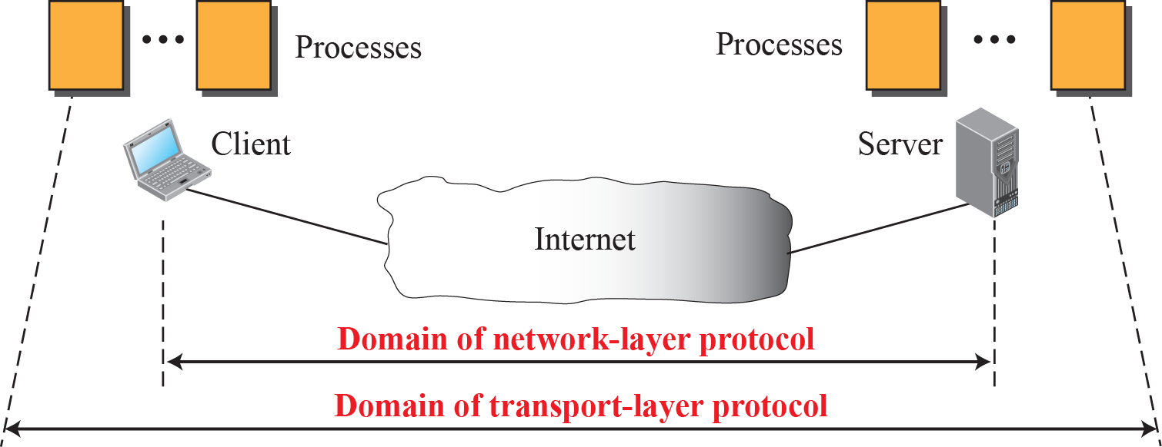
Domain of Transport Layer Protocol

Slide 4
The Transport Service
Services provided to the upper layers
Transport service primitives
Berkeley sockets
Example of socket programming: an Internet file server

Slide 5
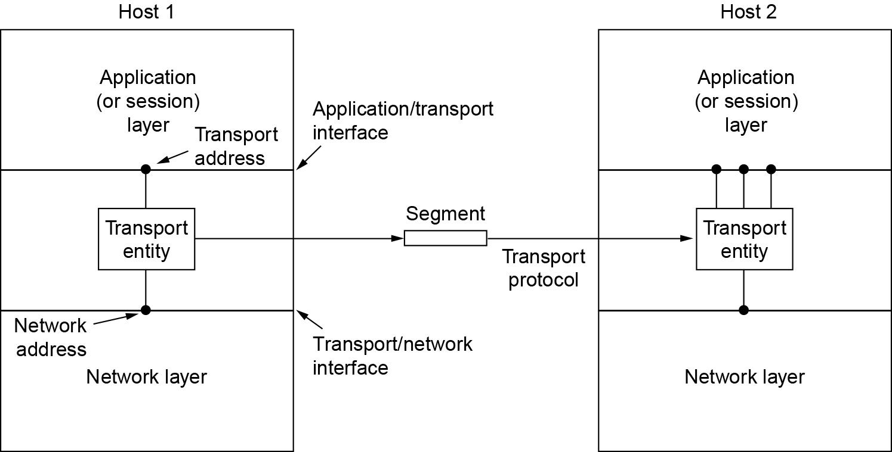
Services Provided to the Upper Layers
Transport layer adds reliability to the network layer
Offers connectionless (e.g., UDP) and connection-oriented (e.g, TCP) service to applications
The network, transport, and application layers

Slide 6
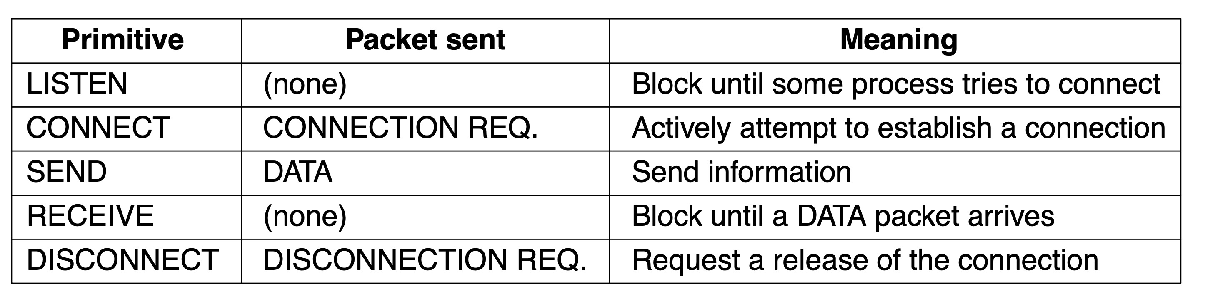
Transport Service Primitives (1 of 2)
Primitives that applications might call to transport data for a simple connection-oriented service:
Client calls CONNECT, SEND, RECEIVE, DISCONNECT
Server calls LISTEN, RECEIVE, SEND, DISCONNECT
The primitives for a simple transport service

Slide 7
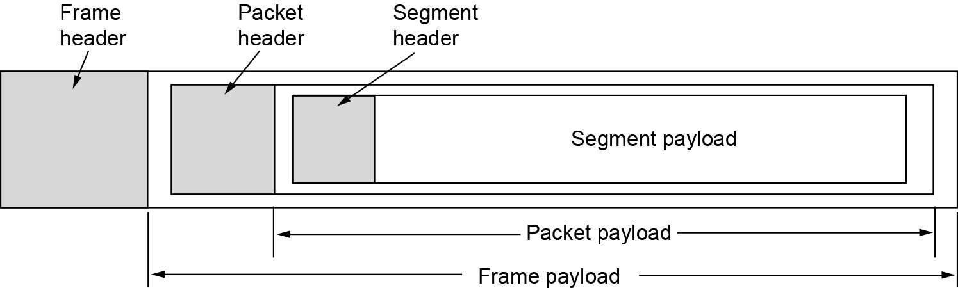
Transport Service Primitives (2 of 2)
Transport layer sends segments in packets (in frames)
Nesting of segments, packets, and frames

Slide 8
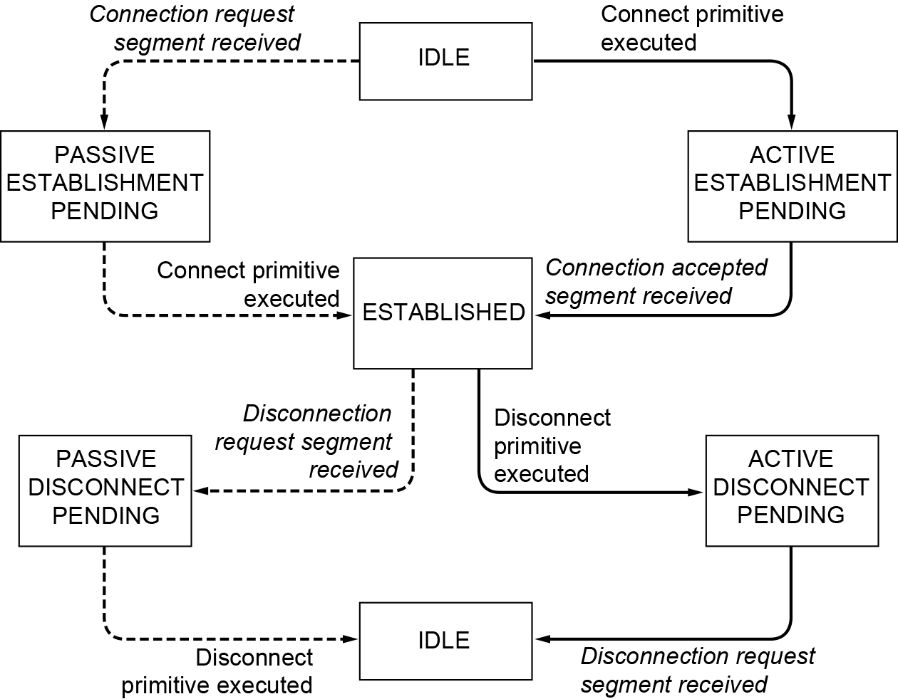
Berkeley Sockets (1 of 2)
A state diagram for a simple connection management scheme. Transitions labeled in italics are caused by packet arrivals. The solid lines show the client’s state sequence. The dashed lines show the server’s state sequence.

Slide 9
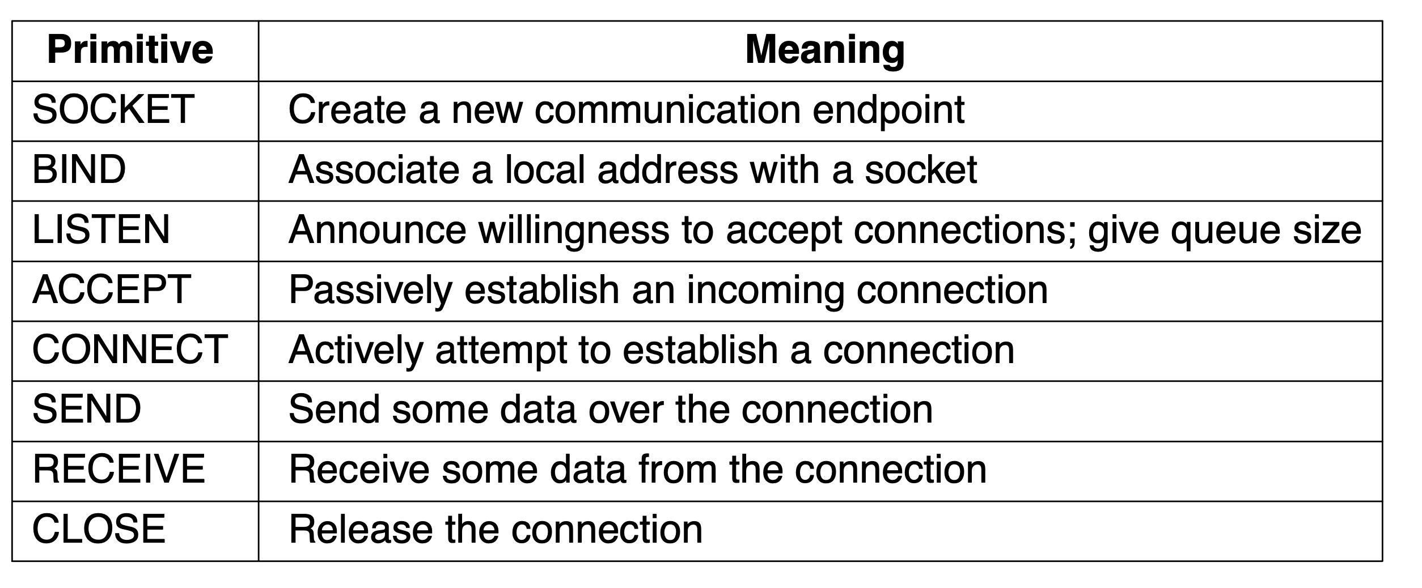
Berkeley Sockets (2 of 2)
The socket primitives for TCP

Slide 10
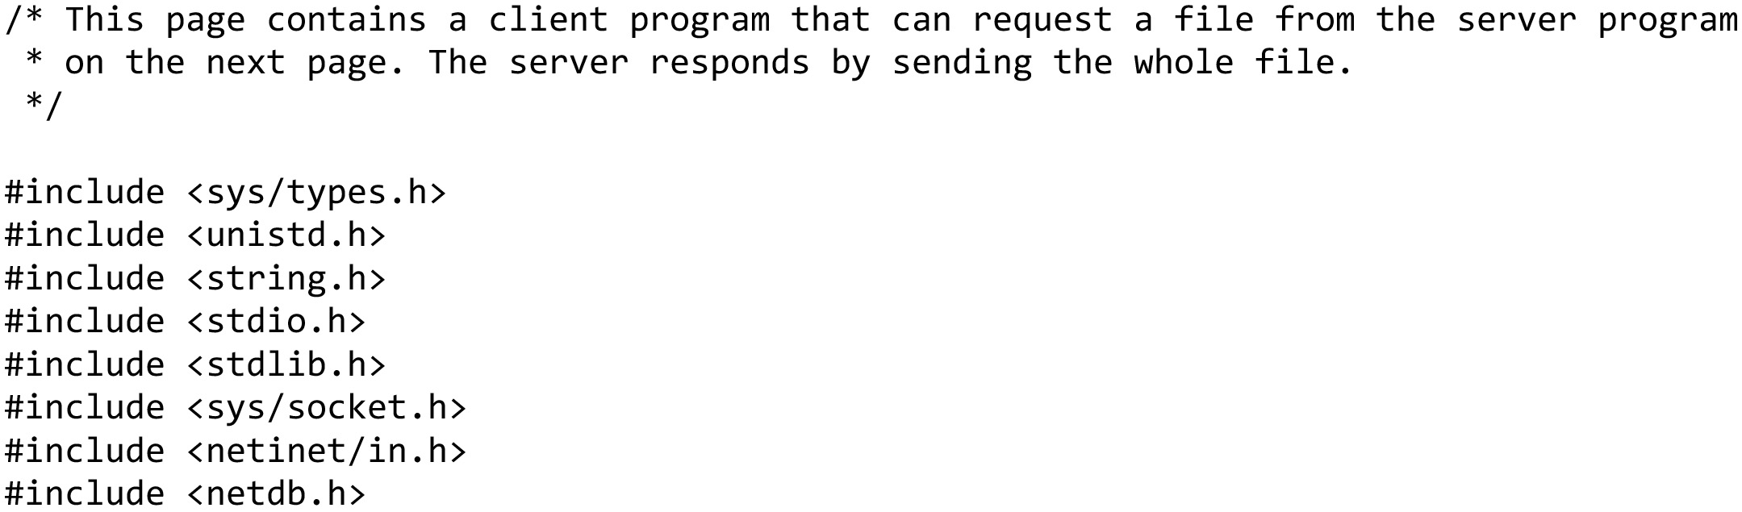
An Example of Socket Programming: An Internet File Server (1 of 10)
Client code using sockets … continued on the next slide

Slide 11
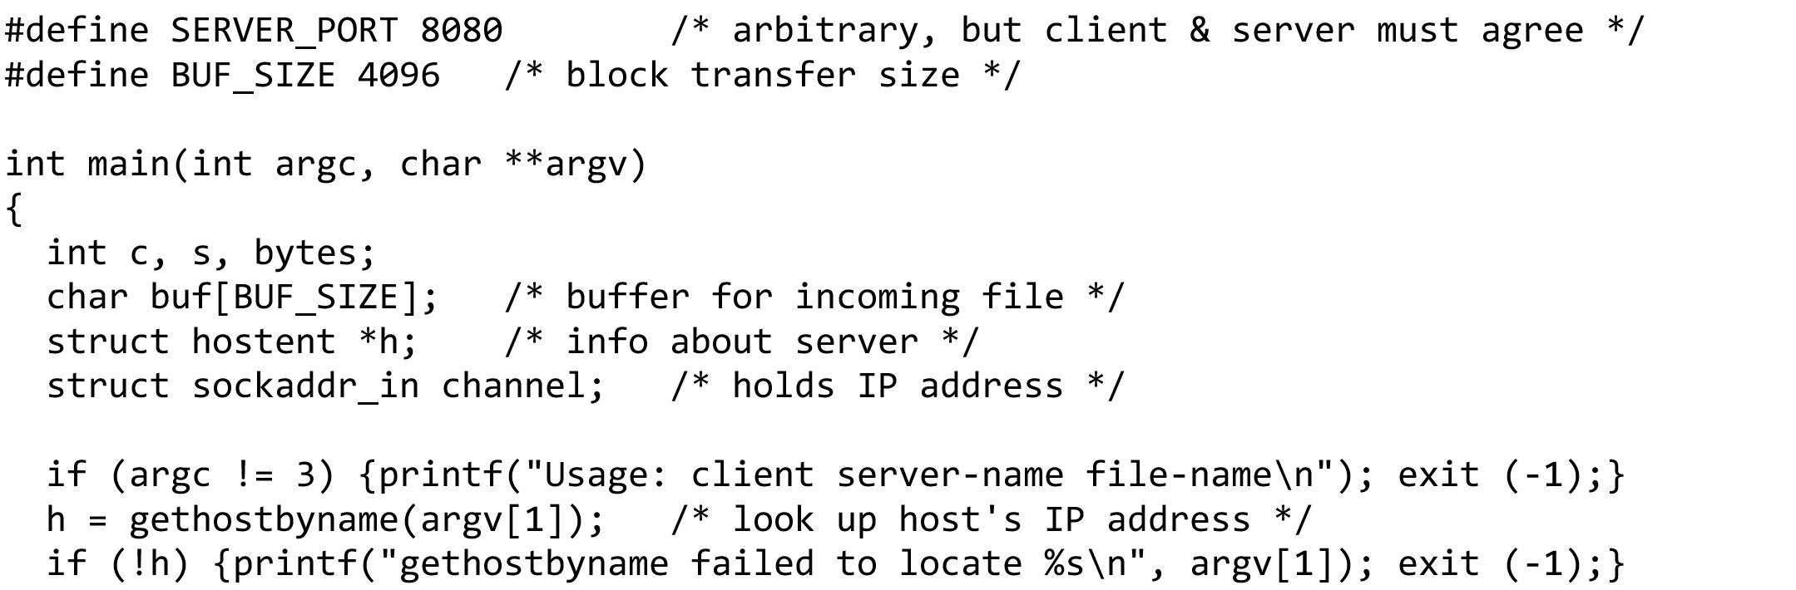
An Example of Socket Programming: An Internet File Server (2 of 10)
Get server’s IP address
Client code using sockets … continued on the next slide

Slide 12
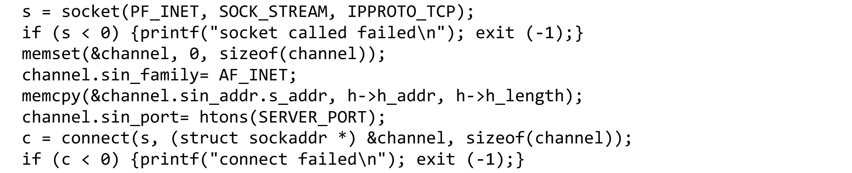
An Example of Socket Programming: An Internet File Server (3 of 10)
Make a socket
Try to connect
Client code using sockets … continued on the next slide

Slide 13
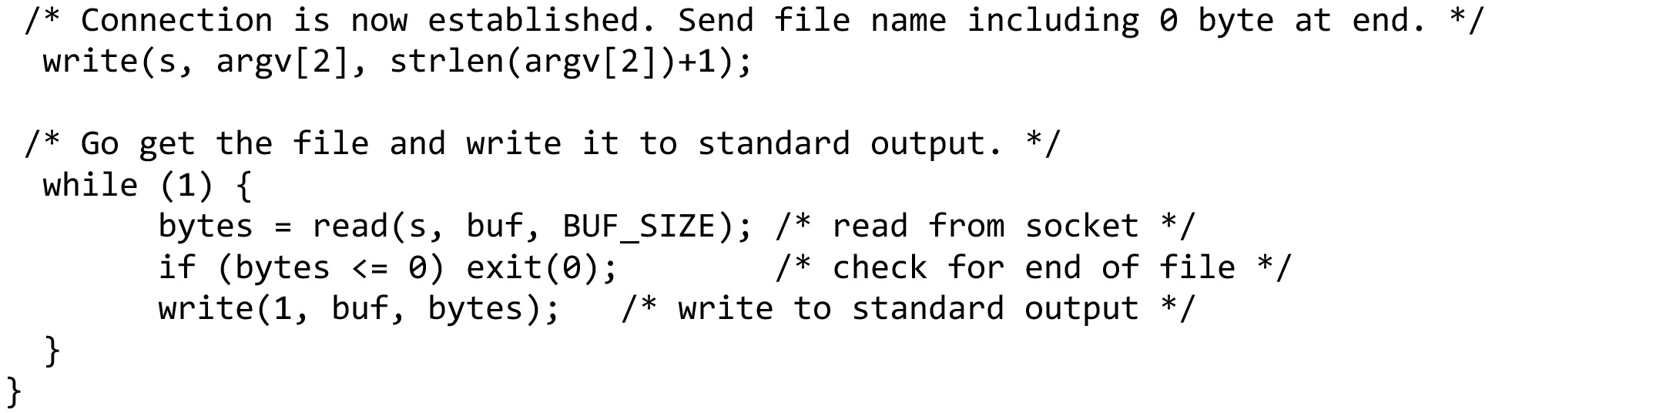
An Example of Socket Programming: An Internet File Server (4 of 10)
Write data (equivalent to send)
Loop reading (equivalent to receive) until no more data; exit implicitly calls close
Client code using sockets (end of client code)

Slide 14
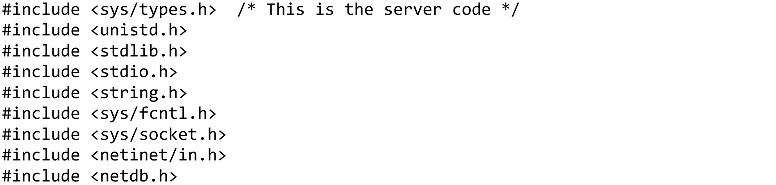
An Example of Socket Programming: An Internet File Server (5 of 10)
Server code using sockets … continued on the next slide

Slide 15
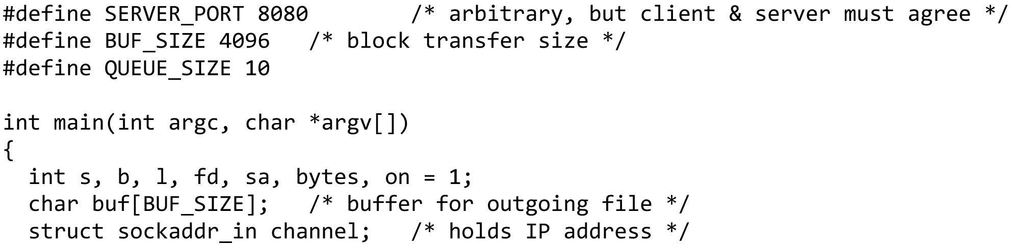
An Example of Socket Programming: An Internet File Server (6 of 10)
Server code using sockets … continued on the next slide

Slide 16
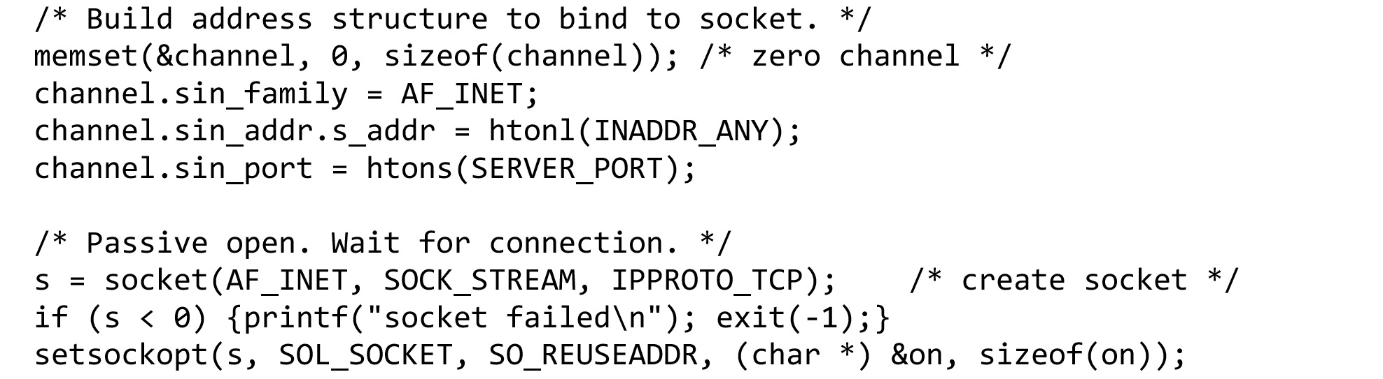
An Example of Socket Programming: An Internet File Server (7 of 10)
Make a socket
Server code using sockets … continued on the next slide

Slide 17
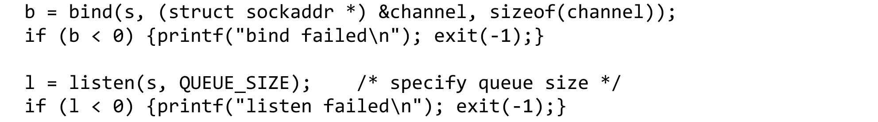
An Example of Socket Programming: An Internet File Server (8 of 10)
Assign address
Prepare for incoming connections
Server code using sockets … continued on the next slide

Slide 18
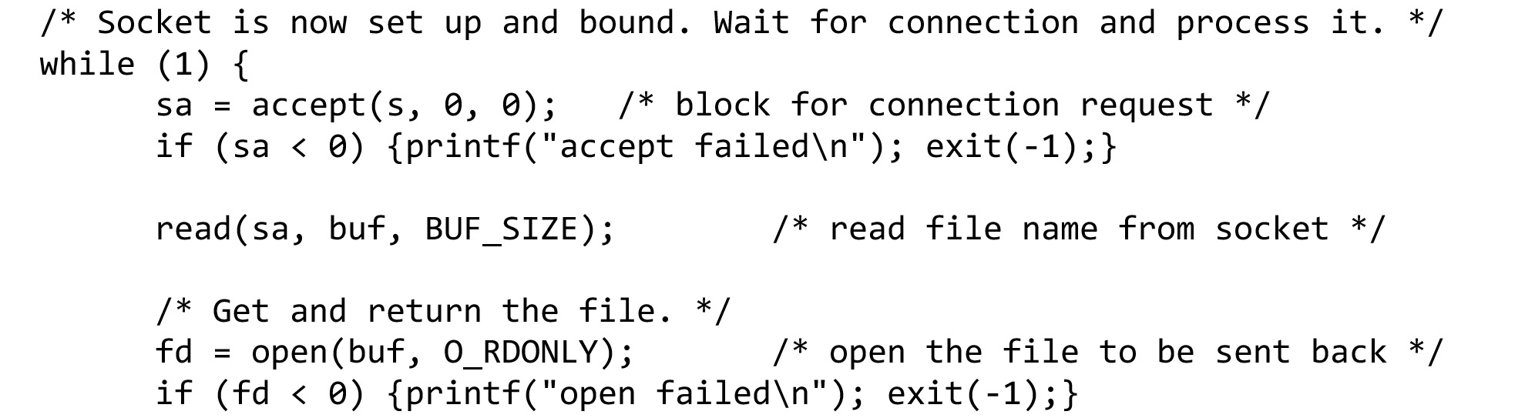
An Example of Socket Programming: An Internet File Server (9 of 10)
Block waiting for the next connection
Read (receive) request and treat as file name
Server code using sockets … continued on the next slide

Slide 19
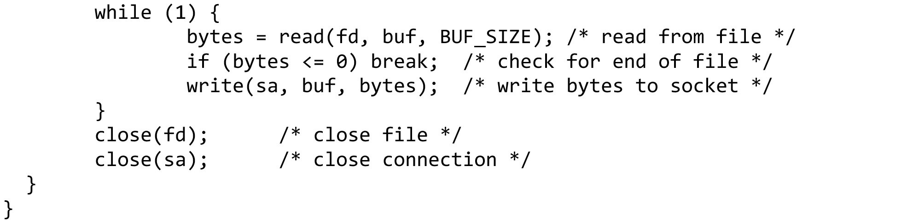
An Example of Socket Programming: An Internet File Server (10 of 10)
Write (send) all file data
Done, so close this connection
Server code using sockets (end of code)

Slide 20
The Transport Layer Chapter 6
The Transport Service
Elements of Transport Protocols
Congestion Control
The Internet Transport Protocols: UDP
The Internet Transport Protocols: TCP
Performance Monitoring
Summary

Slide 21
Elements of Transport Protocols (1 of 2)
Addressing
Connection establishment
Problem: Delayed and duplicate packets
Solution: Three-way handshake
Connection release
Error control and flow control
Multiplexing
Crash recovery

Slide 22
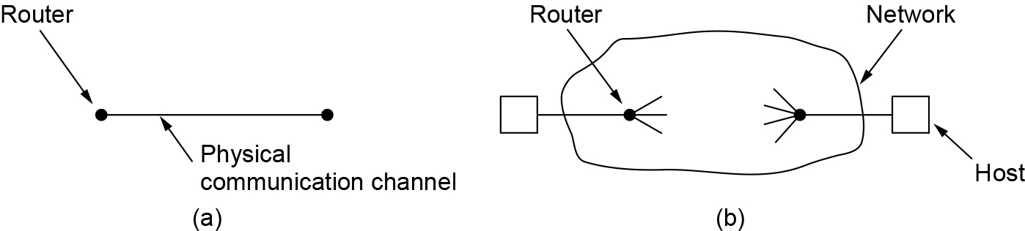
Elements of Transport Protocols (2 of 2)
Item | Data Link Layer | Transport Layer
Addressing | Usually no need | Explicit addressing
Process of establishing a connection | Simple | Complicated
Storage capacity in the network | N/A | Delay and duplicate packets
Degree | Fixed allocation is enough | Large and varying number of connections must be managed. Bandwidth variations must be considered.
(a) Environment of the data link layer. (b) Environment of the transport layer.

Slide 23
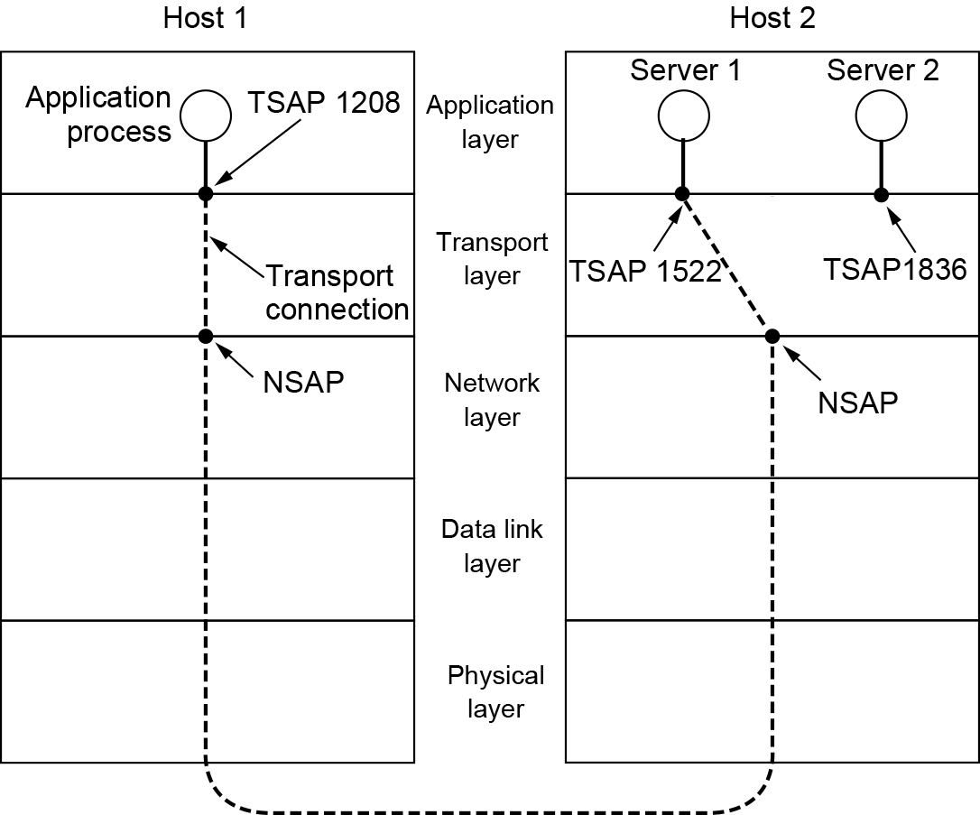
Addressing (1 of 2)
Transport layer adds TSAPs
Multiple clients and servers can run on a host with a single network (IP) address
TSAPs are ports for TCP/UDP
TSAPs, NSAPs, and transport connections

Slide 24
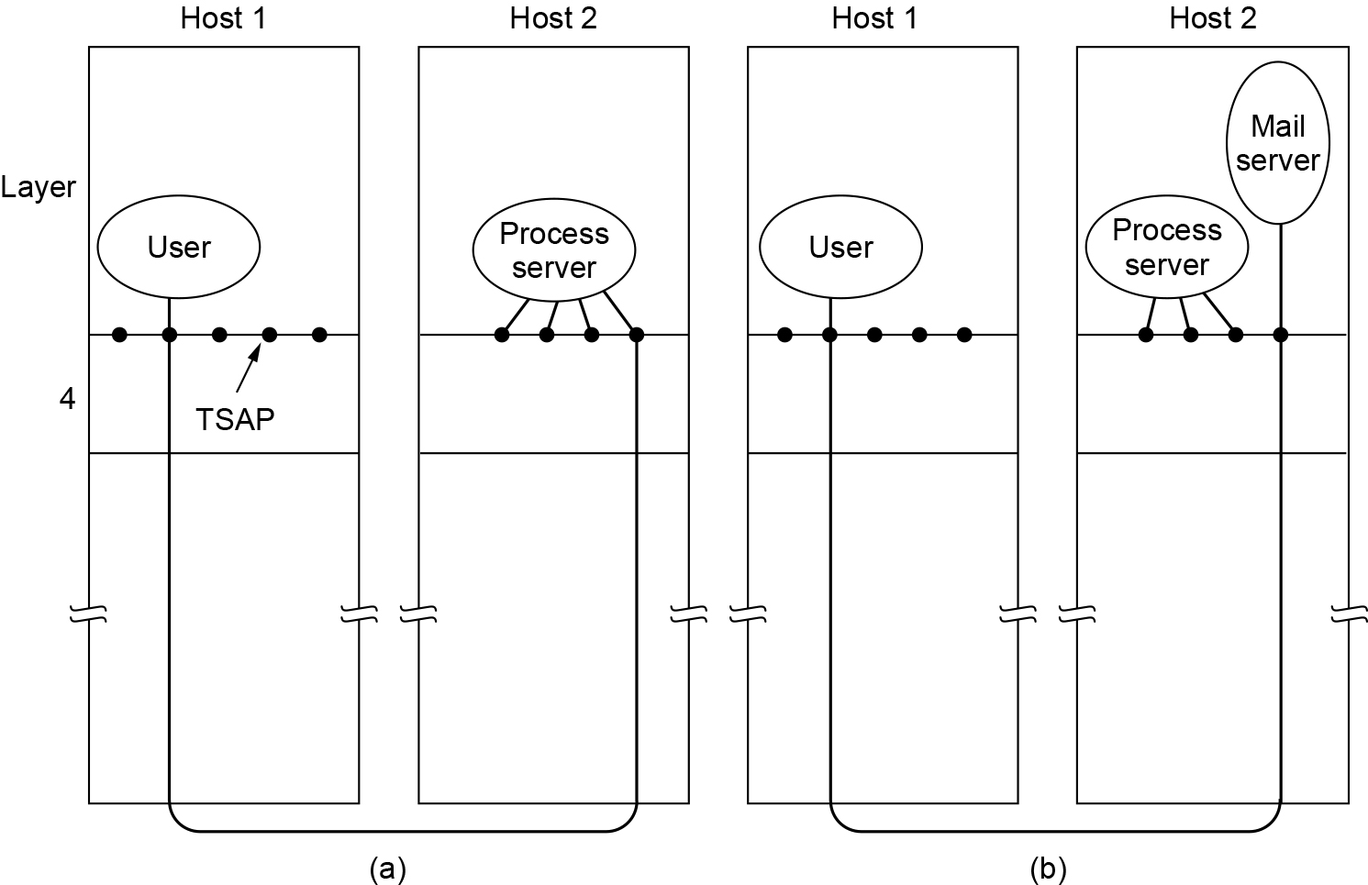
Addressing (2 of 2)
How a user process in host 1 establishes a connection with a mail server in host 2 via a process server

Slide 25
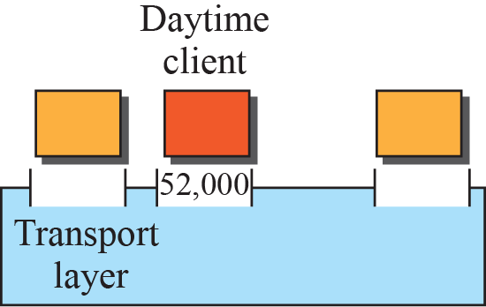
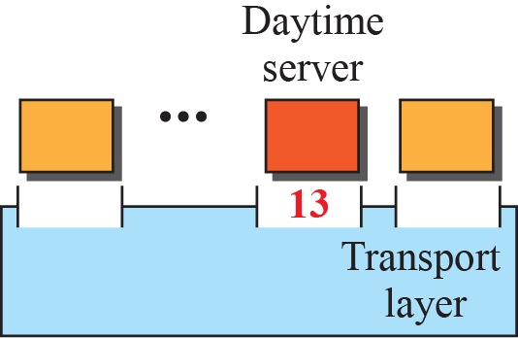
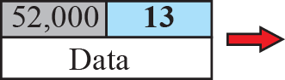
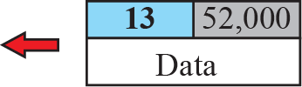
Port Numbers

Slide 26
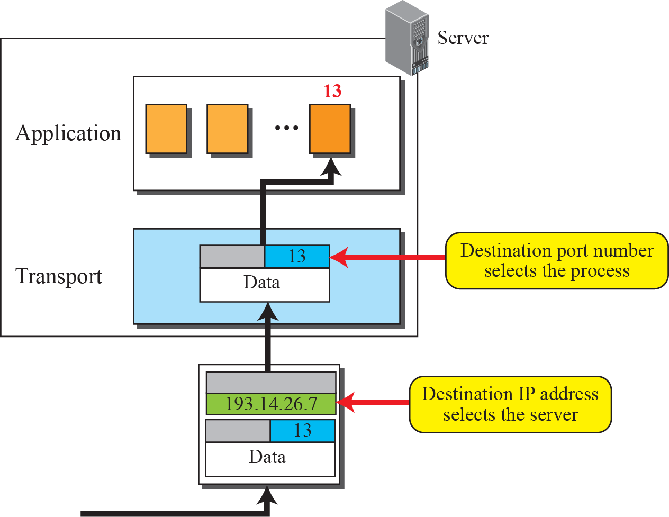
IP Addresses VS. Port Numbers

Slide 27
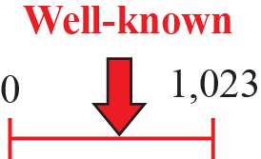
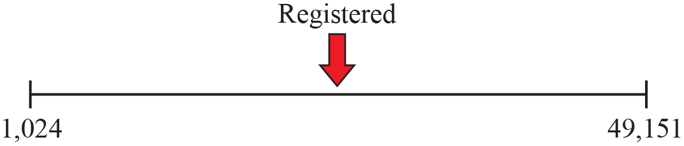
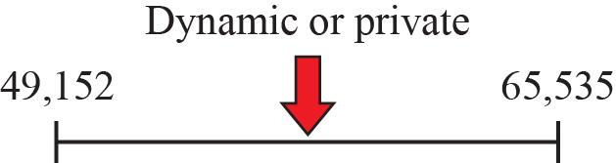
ICANN Ranges
In UNIX, the well-known ports are stored in a file called /etc/services.

Slide 28
Connection Establishment
Key problem is to ensure reliability even though packets may be lost, corrupted, delayed, and duplicated
Don’t treat an old or duplicate packet as new
(Use ARQ and checksums for loss/corruption)
Techniques for restricting packet (including all acknowledgements) lifetime
Restricted network design
Putting a hop counter in each packet
Timestamping each packet
Don’t reuse sequence numbers within twice the MSL (Maximum Segment Lifetime) of T=240 secs (guarantee not only that a packet is dead, but also that all acknowledgements to it are dead)
Notes:
duplicated and delayed packets must be rejected as duplicates and not processed as fresh packets.
Rather than allowing packets to live forever within the network, we devise a mechanism to kill off aged packets that are still hobbling about.

Slide 29
Practical way to reject delayed duplicate segments
Prerequisites: packet lifetimes bounded
The source labels segments with sequence numbers that will not be reused within T secs.
The period, T, and the rate of packets per second determine the size of the sequence numbers.
Only one packet with a given sequence number may be outstanding at any given time.
Duplicates of this packet may still occur, and they must be discarded by the destination.

Slide 30
Problem of a machine losing all memory of where it was after a crash (1)
Solution1: Require transport entities to be idle for T secs after a recovery.
The idle period will let all old segments die off, so the sender can start again with any sequence number.
However, in a complex internetwork, T may be large, so this strategy is unattractive.

Slide 31
Problem of a machine losing all memory of where it was after a crash (2)
Solution2: Each host is equipped with a time-of-day clock
The clocks at different hosts need not be synchronized. Each clock is assumed to take the form of a binary counter that increments itself at uniform intervals. The number of bits in the counter must equal or exceed the number of bits in the sequence numbers.
The clock is assumed to continue running even if the host goes down. When a connection is set up, the low-order k-bits of the clock are used as the k-bit initial sequence number. Each connection starts numbering its segments with a different initial sequence number.
The sequence space should be so large that by the time sequence numbers wrap around, old segments with the same sequence number are long gone.

Slide 32
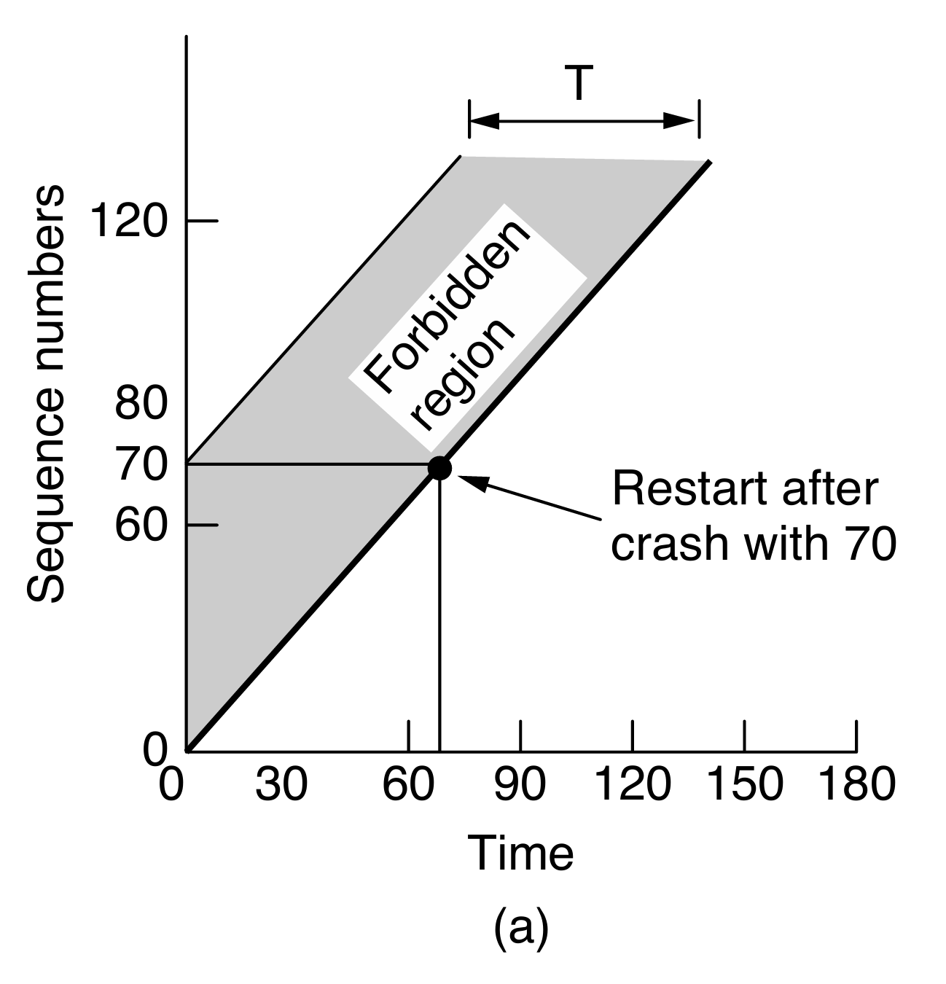
Sending too fast will cause the sequence number entering the forbidden region
If a host sends too much data too fast on a newly opened connection, the actual sequence number versus time curve may rise more steeply than the initial sequence number versus time curve.
The maximum data rate on any connection is one segment per clock tick. The transport entity must wait until the clock ticks before opening a new connection after a crash restart, lest the same number be used twice. However, the clock cannot tick too fast relative to the sequence number.
For a clock rate of C and a sequence number space of size S, we must have S/C > T so that the sequence numbers cannot wrap around too quickly.
If the host crashes and restarts at time 70 seconds, it will use initial sequence numbers based on the clock to pick up after it left off;
The host does not start with a lower sequence number in the forbidden region.
Notes:
Once both transport entities have agreed on the initial sequence number, any sliding window protocol can be used for data flow control. This window protocol will correctly find and discard duplicates of packets after they have already been accepted. In reality, the initial sequence number curve (shown by the heavy line) is not linear, but a staircase, since the clock advances in discrete steps. For simplicity, we will ignore this detail.

Slide 33
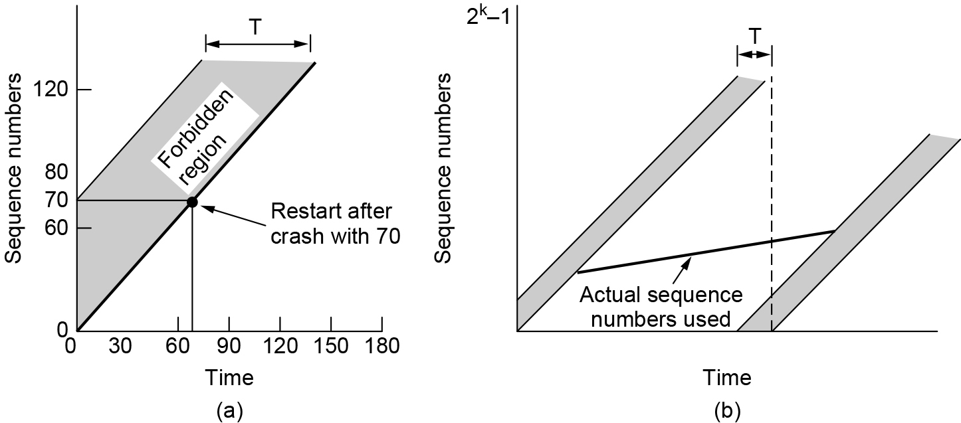
Sending too slow will also cause the sequence number entering the forbidden region
Any data rate less than the clock rate, the curve of actual sequence numbers used versus time will eventually run into the forbidden region from the left as the sequence numbers wrap around.
The greater the slope of the actual sequence numbers, the longer this event will be delayed.
Avoiding this situation limits how slowly sequence numbers can advance on a connection (or how long the connections may last).
(a) Segments may not enter the forbidden region. (b) The resynchronization problem.
Notes:
seq. number do not wrap within T seconds
seq. number do not climb too slowly for too long

Slide 34
Summary
Use a sequence number space large enough that it will not wrap, even when sending at full rate
Clock (high bits) advances & keeps state over crash
clock rate: C, sequence number space size: S, S/C > T so that the sequence numbers cannot wrap around too quickly.
limits how slowly sequence numbers can advance on a connection
In TCP, the sequence number used for detecting duplicates is treated as the combination of a timestamp and 32 bit sequence number. It won’t wrap within 2MSL = 4 minutes (satisfying the left side) and will rise fast enough (avoiding the problem on the right hand side)
Notes:
The MSL of 2 minutes is just an engineering bound that is conservative (and probably too high these days). Twice the MSL is used to ensure that neither a packet nor an acknowledgment for the packet can still be in the network.

Slide 35
Three-way Handshake Connection Establishment (1 of 3)
The clock-based method solves the problem of not being able to distinguish delayed duplicate segments from new segments.
However, there is a practical snag for using it for establishing connections. Since we do not normally remember sequence numbers across connections at the destination, we still have no way of knowing if a CONNECTION REQUEST segment containing an initial sequence number is a duplicate of a recent connection.
This snag does not exist during a connection because the sliding window protocol does remember the current sequence number.
Notes:
基于时钟的方法解决了无法区分延迟的重复数据段和新数据段的问题，但对于连接建立请求数据段中的起始序号，无法确定是否重复。因为通信对方无法获知并记住初始序号

Slide 36
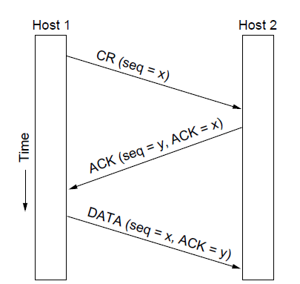
Three-way Handshake Connection Establishment (2 of 3)
Three-way handshake used for initial packet
Since no state from previous connection
Both hosts contribute fresh seq. numbers
CR = Connect Request
For the initial packet we can’t tell if it is a duplicate by looking to see if the sequence number has already been received without remembering state across connections, and we don’t want to do that.
The 3-way handshake is used instead. Having both hosts contribute fresh sequence numbers (x and y) is key.

Slide 37
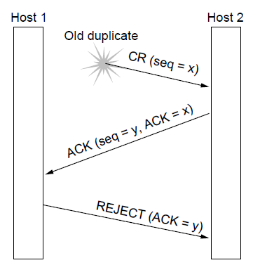
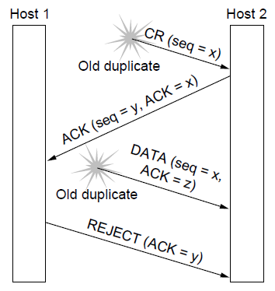
Three-way Handshake Connection Establishment (3 of 3)
Three-way handshake protects against odd cases:
a) Duplicate CR. Spurious ACK does not connect
b) Duplicate CR and DATA. Same plus DATA will be rejected (wrong ACK).
X
X
X
a)
b)

Slide 38
Connection establishment in TCP
TCP always uses this three-way handshake to establish connections.
Within a connection, a timestamp is used to extend the 32-bit sequence number so that it will not wrap within the maximum packet lifetime, even for gigabit-per-second connections. This mechanism is a fix to TCP that was needed as it was used on faster and faster links. It is described in RFC 1323 and called PAWS (Protection Against Wrapped Sequence numbers).
Across connections, for the initial sequence numbers and before PAWS can come into play, TCP originally used the clock-based scheme just described.

Slide 39
Security vulnerability of clock-based scheme
The clock made it easy for an attacker to predict the next initial sequence number and send packets that tricked the three-way handshake and established a forged connection.
To close this hole, pseudorandom initial sequence numbers are used for connections in practice.
However, it remains important that the initial sequence numbers not repeat for an interval even though they appear random to an observer. Otherwise, delayed duplicates can wreak havoc.
Notes:
Wreak havoc：造成严重破坏

Slide 40
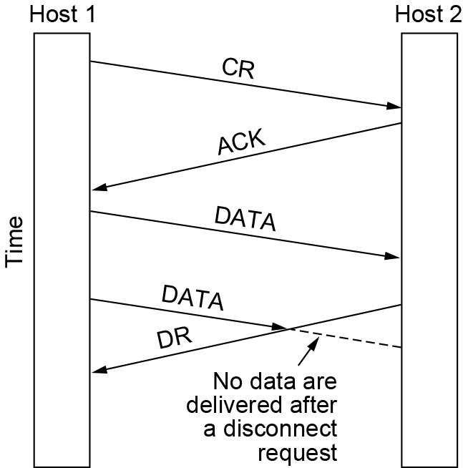
Three-way Handshake Connection Release (1 of 3)
Key problem is to ensure reliability while releasing
Asymmetric release (when one side breaks connection) is abrupt and may lose data
Abrupt disconnection with loss of data

Slide 41
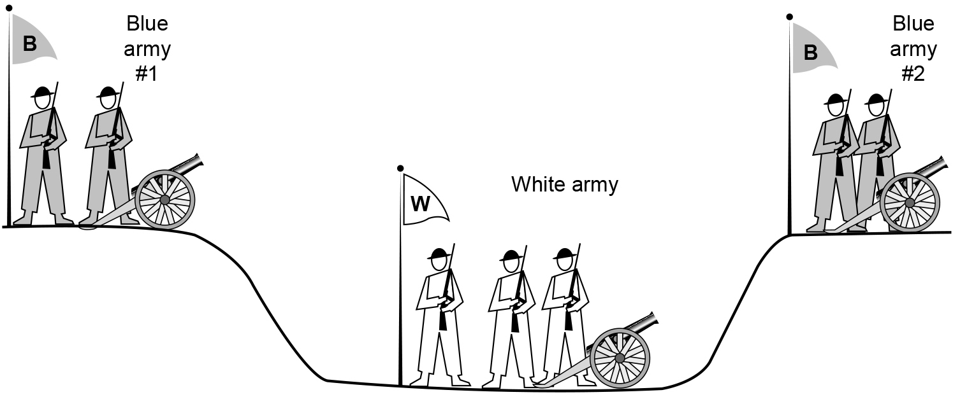
Connection Release (2 of 3)
Symmetric release (both sides agree to release) can’t be handled solely by the transport layer
Two-army problem shows pitfall of agreement
The two-army problem

Slide 42
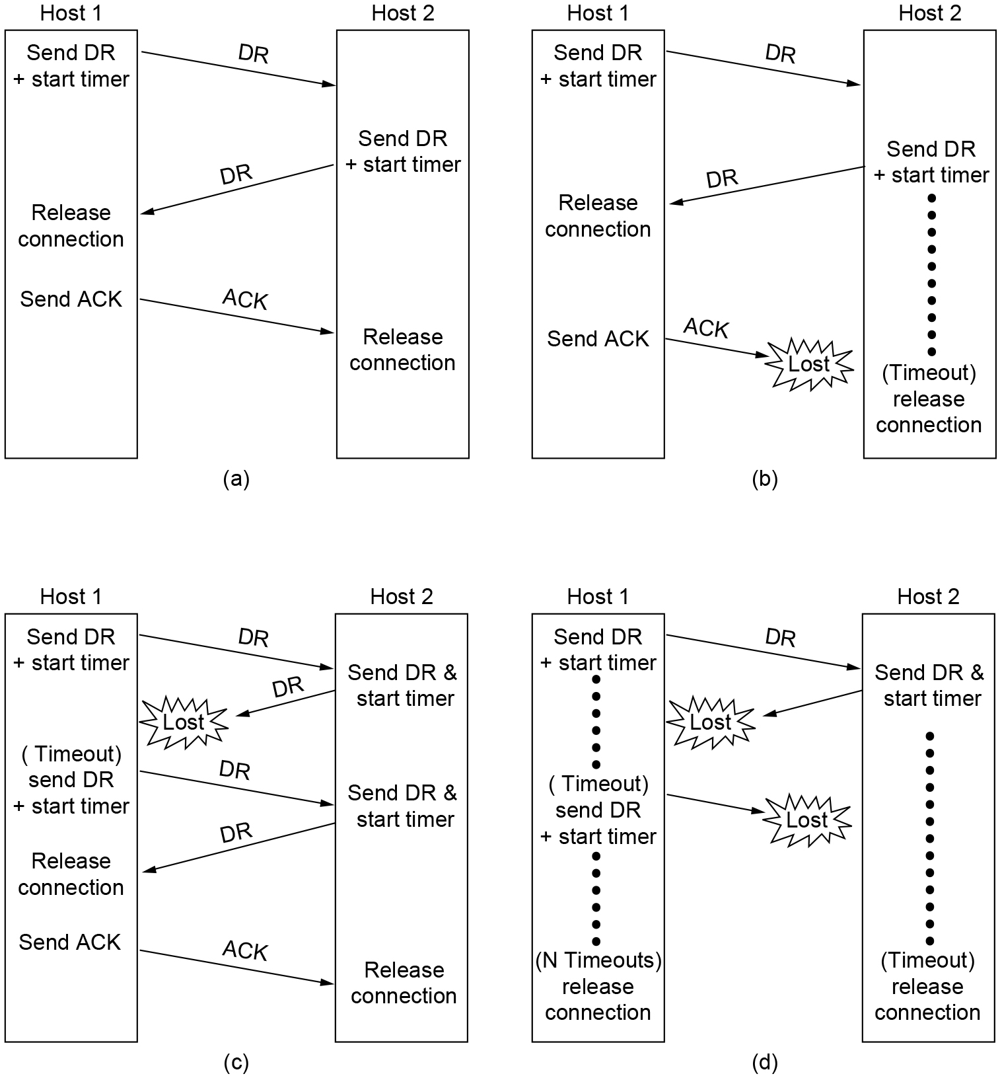
Connection Release (3 of 3)
Four protocol scenarios for releasing a connection. (a) Normal case of three-way handshake. (b) Final ACK lost. (c) Response lost. (d) Response lost and subsequent DRs lost.

Slide 43
Error Control and Flow Control (1 of 3)
Foundation for error control is a sliding window (from Link layer) with checksums and retransmissions
Flow control manages buffering at sender/receiver
Issue is that data goes to/from the network and applications at different times
Window tells sender available buffering at receiver
Makes a variable-size sliding window

Slide 44
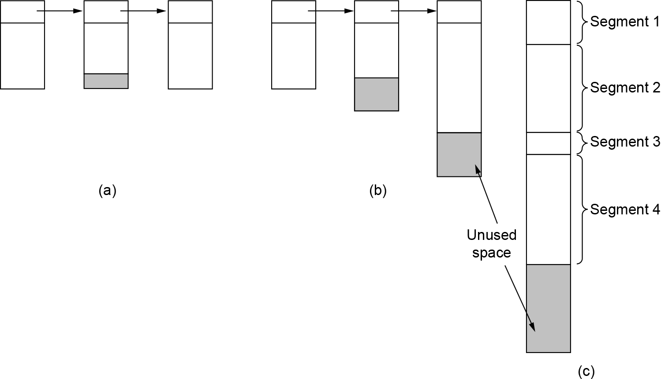
Error Control and Flow Control (2 of 3)
efficiency VS. complexity
(a) Chained fixed-size buffers. (b) Chained variable-sized buffers. (c) One large circular buffer per connection.

Slide 45
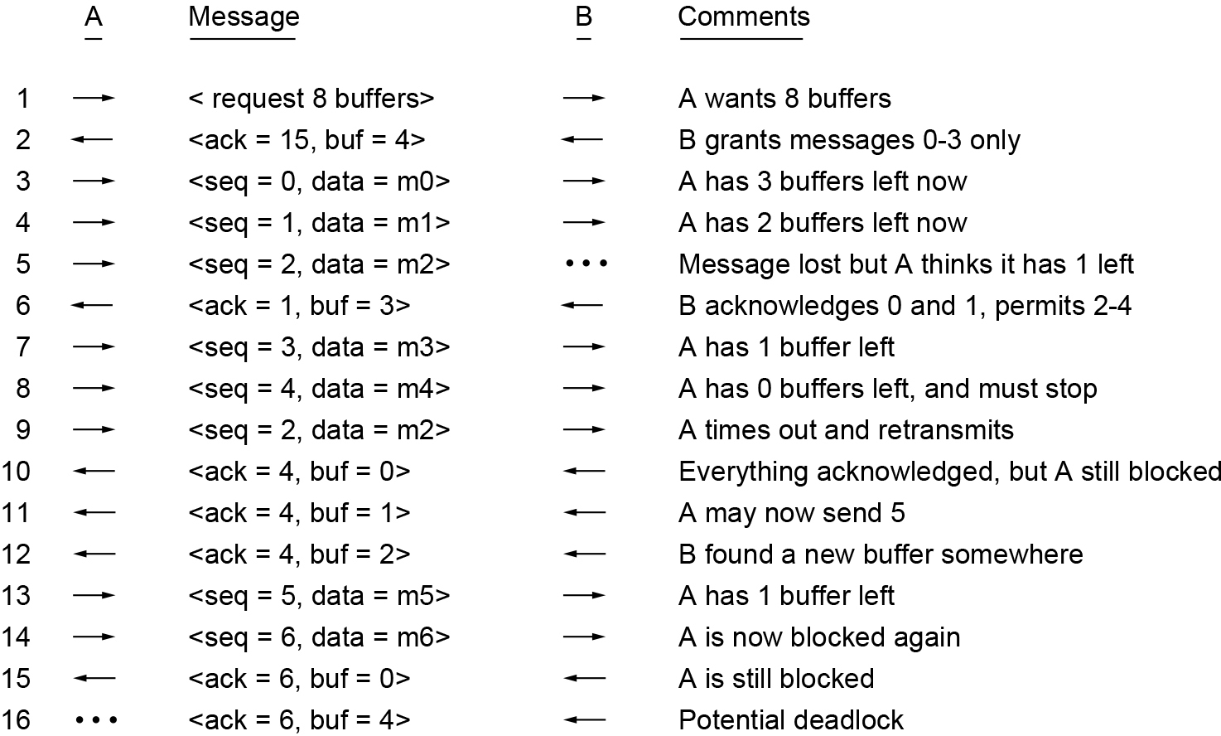
Error Control and Flow Control (3 of 3)
Q: when does B’s application receive data from the buffer?
A: Between times 5&6, 10&11, 11&12, and 15&16.
B’s Buffer
0
1
2
3
0
1
2
3
0
1
2
3
0
1
2
3
1
2
3
4
1
2
3
4
1
2
3
4
1
2
3
4
1
2
3
4
2
3
4
5
3
4
5
6
3
4
5
6
3
4
5
6
3
4
5
6
7
8
9
10
Q: why is there a potential deadlock at the end?
Dynamic buffer allocation. The arrows show the direction of transmission. An ellipsis (...) indicates a lost segment.
Notes:
Q: why is there a potential deadlock at the end?
A: Because A is waiting for an indication of new buffer space (via an ACK) and B is waiting for new data. This problem is avoided by having a timer at either sender or receiver.
(TCP uses a sender window probe, a periodic probe that stimulates the receiver when the sender has data to send and thinks the window is full.)

Slide 46
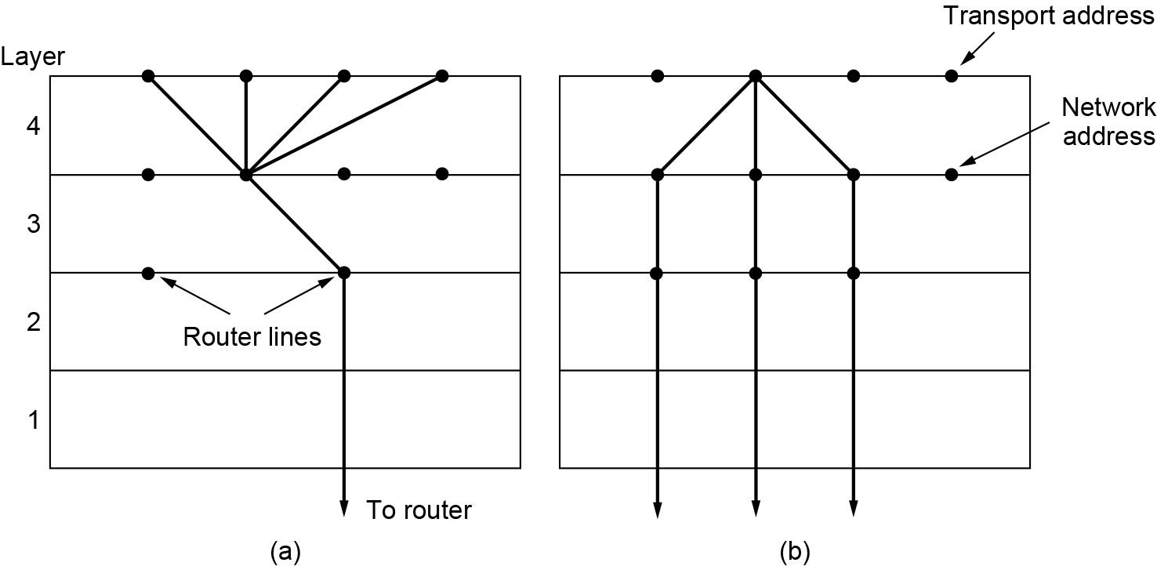
Multiplexing
Kinds of transport / network sharing that can occur:
Multiplexing: connections share a network address
Inverse multiplexing: addresses share a connection
(a) Multiplexing. (b) Inverse multiplexing.

Slide 47
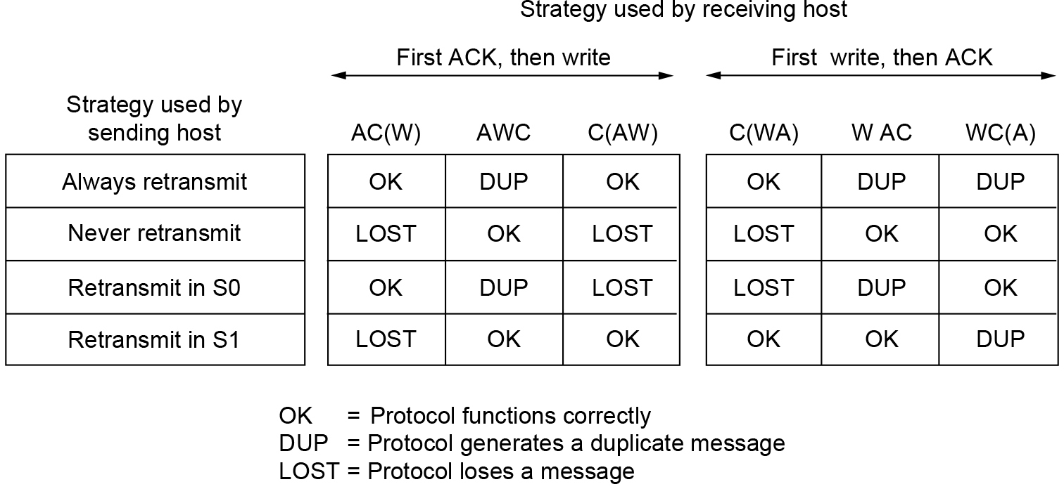
Crash Recovery
Application needs to help recovering from a crash
Transport can fail since A(ck) / W(rite) not atomic
S1: one segment outstanding
S0: no segments outstanding
Different combinations of client and server strategies
Recovery from a layer N crash can only be done by layer N + 1,
only if the higher layer retains enough status information to reconstruct where it was before the problem occurred
Notes:
假设一个主机（客户端）正在使用简单的停止和等待协议将长文件发送到另一个主机（文件服务器）。服务器上的传输层只是将传入的 segment 逐个传递给传输用户。传输过程中，服务器崩溃。当它重新启动时，它的表会重新初始化，因此它不再确切地知道它在哪里。
为了尝试恢复其以前的状态，服务器可能会向所有其他主机发送一个广播段，宣布它刚刚崩溃，并请求其客户端通知它所有打开的连接的状态。每个客户端可以处于以下两种状态之一：一个段未完成 S1 或无段未完成 S0。仅根据此状态信息，客户端必须决定是否重新传输最近的分段。
使协议更详细无济于事。即使 Client 端和服务器在服务器尝试写入之前交换了几个 Segment，以便 Client 端确切地知道将要发生什么，但 Client 端也无法知道崩溃是在写入之前还是之后发生的。结论是不可避免的：
根据我们不能同时发生的事件的基本规则（即，单独的事件一个接一个地发生，而不是同时发生），主机崩溃和恢复不能对更高层透明。

Slide 48
End-to-end acknowledgement
Consider the case:
a user entering requests for transactions against a remote database.
Suppose that the remote transport entity is programmed to first pass segments to the next layer up and then acknowledge.
The receipt of an acknowledgement back at the user’s machine does not necessarily mean that the remote host stayed up long enough to actually update the database.
A truly end-to-end acknowledgement, whose receipt means that the work has actually been done and lack thereof means that it has not, is probably impossible to achieve.
Notes:
考虑用户针对远程数据库输入事务请求的情况。假设远程传输实体被编程为首先将 Segment 传递到下一层，然后确认。
用户计算机收到确认并不一定意味着远程主机待了足够长的时间以实际更新数据库。
一个真正的端到端的确认，其接收意味着工作实际上已经完成，而没有它意味着它没有完成，可能是不可能实现的。

Slide 49
The Transport Layer Chapter 6
The Transport Service
Elements of Transport Protocols
Congestion Control
The Internet Transport Protocols: UDP
The Internet Transport Protocols: TCP
Performance Monitoring
Summary

Slide 50
Congestion Control
Desirable bandwidth allocation
Efficiency and power
Max-min fairness
Convergence
Regulating the sending rate
Wireless Issues

Slide 51
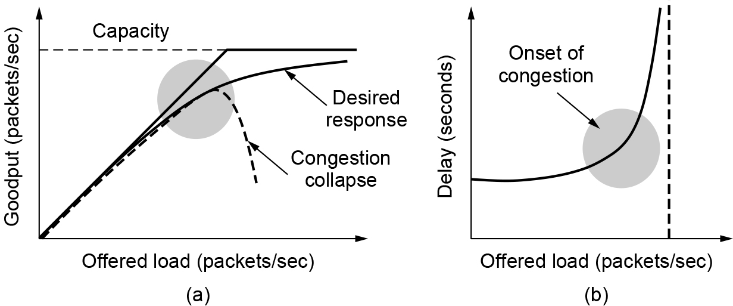
Desirable Bandwidth Allocation (1 of 3)
Efficient use of bandwidth gives high goodput, low delay
Goodput is useful throughput (minus retransmissions).
The power metric is load/delay. It will rise with load until delay starts to climb rapidly. This is one way to find the knee in the curve that is a good operating point.
(a) Goodput and (b) delay as a function of offered load.
Goodput rises more slowly than load when congestion sets in
Delay begins to rise sharply when congestion sets in

Slide 52
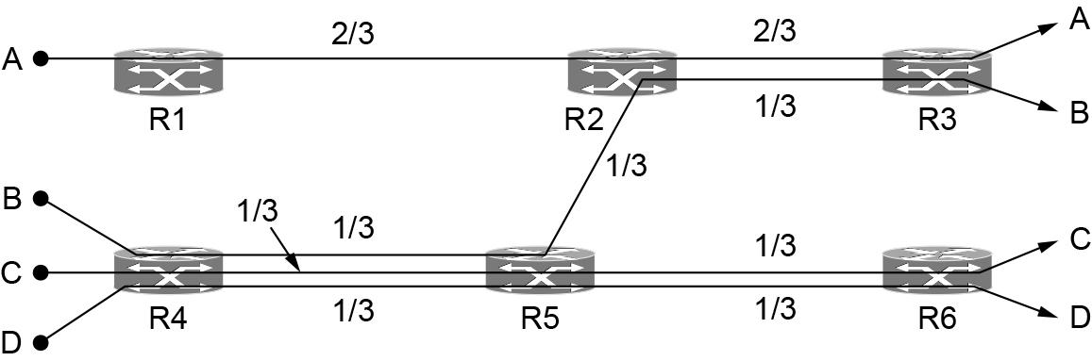
Desirable Bandwidth Allocation (2 of 3)
Fair use gives bandwidth to all flows (no starvation)
Max-min fairness gives equal shares of bottleneck
The bandwidth given to one flow cannot be increased without decreasing the bandwidth given to another flow with an allocation that is no larger. i.e., increasing the bandwidth of a flow will only make the situation worse for flows that are less well off.
Max-min Fairness Allocation
Start with all flows at rate 0;
Increase the flows until there is a new bottleneck in the network;
Hold fixed the rate of the flows that are bottlenecked
Go to step 2 for any remaining flows.
Max-min bandwidth allocation for four flows

Slide 53
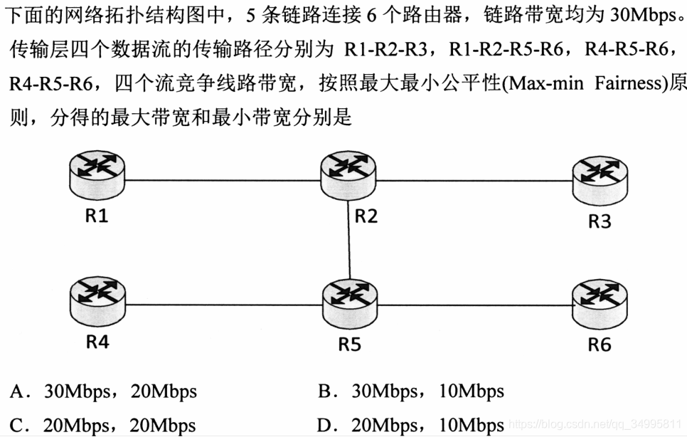

Exercises
R5-R6两跳含3个数据流，30Mbps三等分后得10Mbps。R1-R2-R3能分得20Mbps
故最高为R1-R2-R3： 20Mbps；其他均为最低： 10Mbps。
选D。
10Mbps
20Mbps

Slide 54
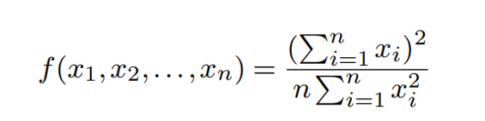
Jain’s Fairness Index
Raj Jain proposed a metric that can be used to quantify the fairness of a congestion –control mechanism.
Given a set of flow throughputs (x₁, x₂, …, x_{n}), the following function assigns a fairness index to the flows:

Slide 55
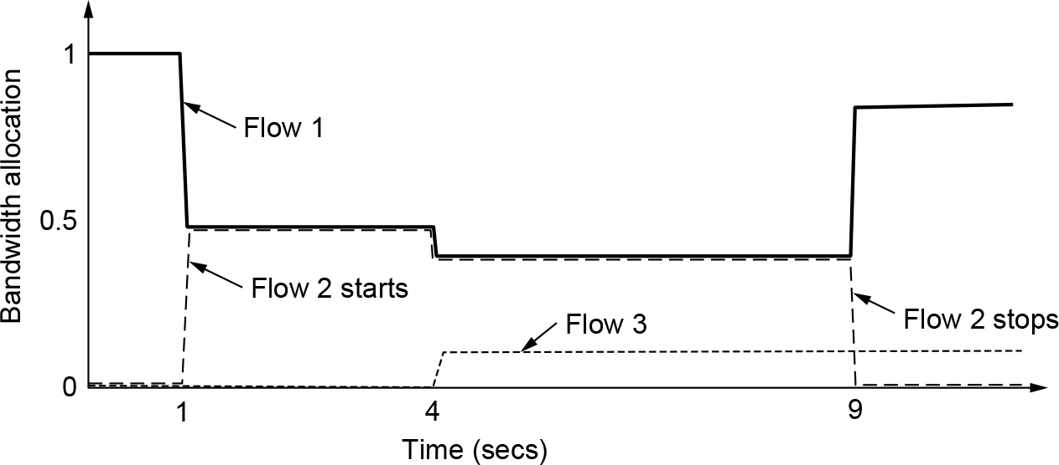
Desirable Bandwidth Allocation (3 of 3)
We want bandwidth levels to converge quickly when traffic patterns change
Flow 1 slows quickly when Flow 2 starts
Flow 1 speeds up quickly when Flow 2 stops
Changing bandwidth allocation over time

Slide 56
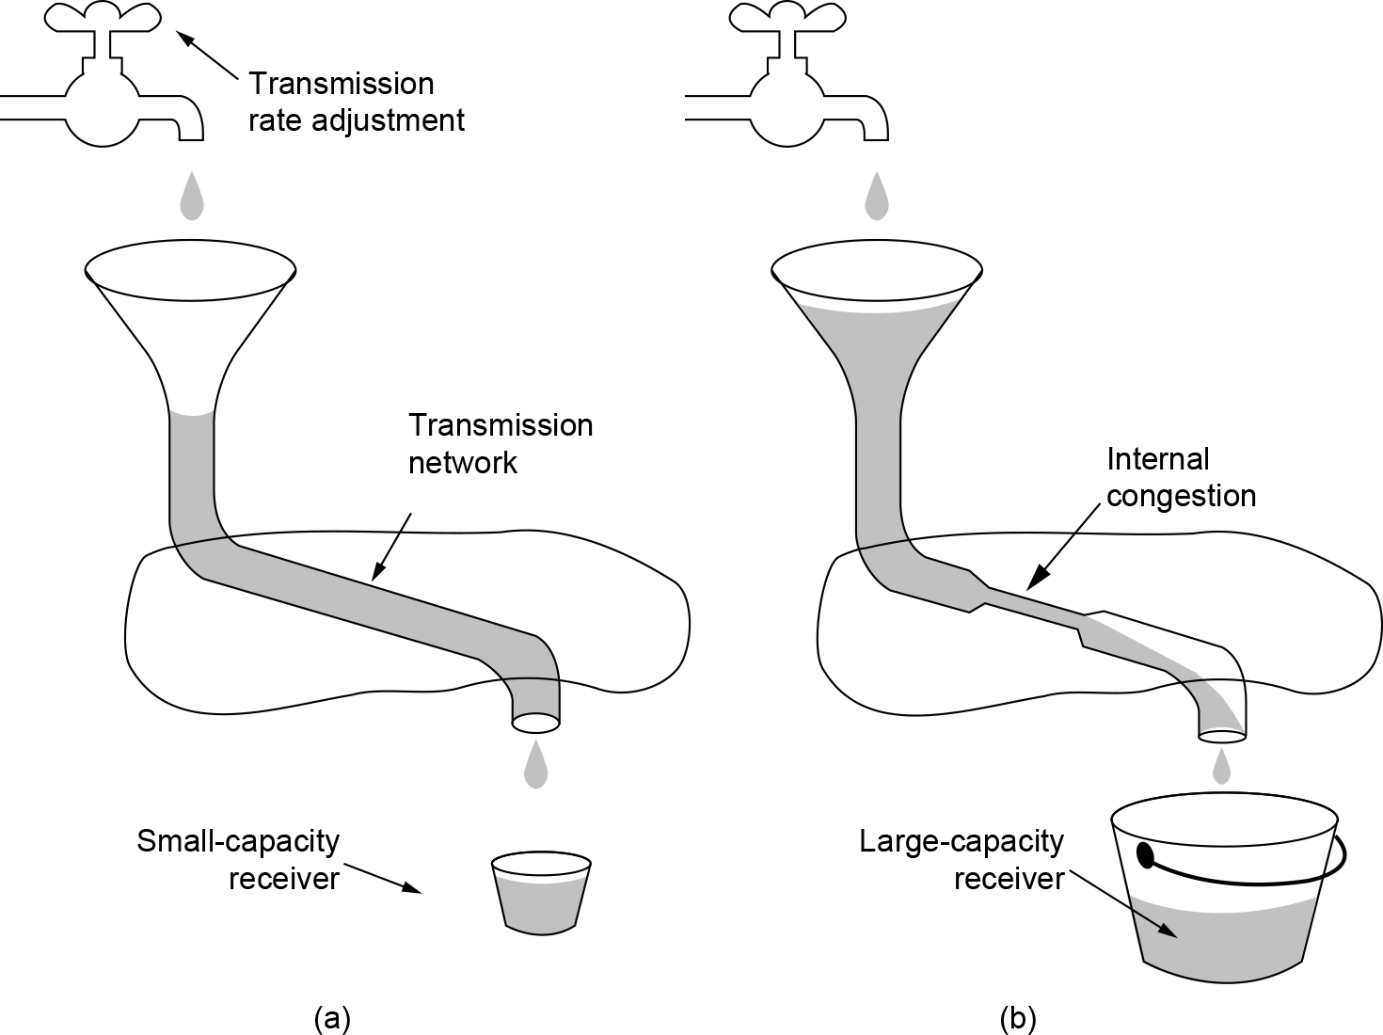
Regulating the Sending Rate (1 of 4)
Sender may need to slow down for different reasons:
Flow control, when the receiver is not fast enough
Congestion, when the network is not fast enough
(a) A fast network feeding a low-capacity receiver. (b) A slow network feeding a high-capacity receiver.

Slide 57
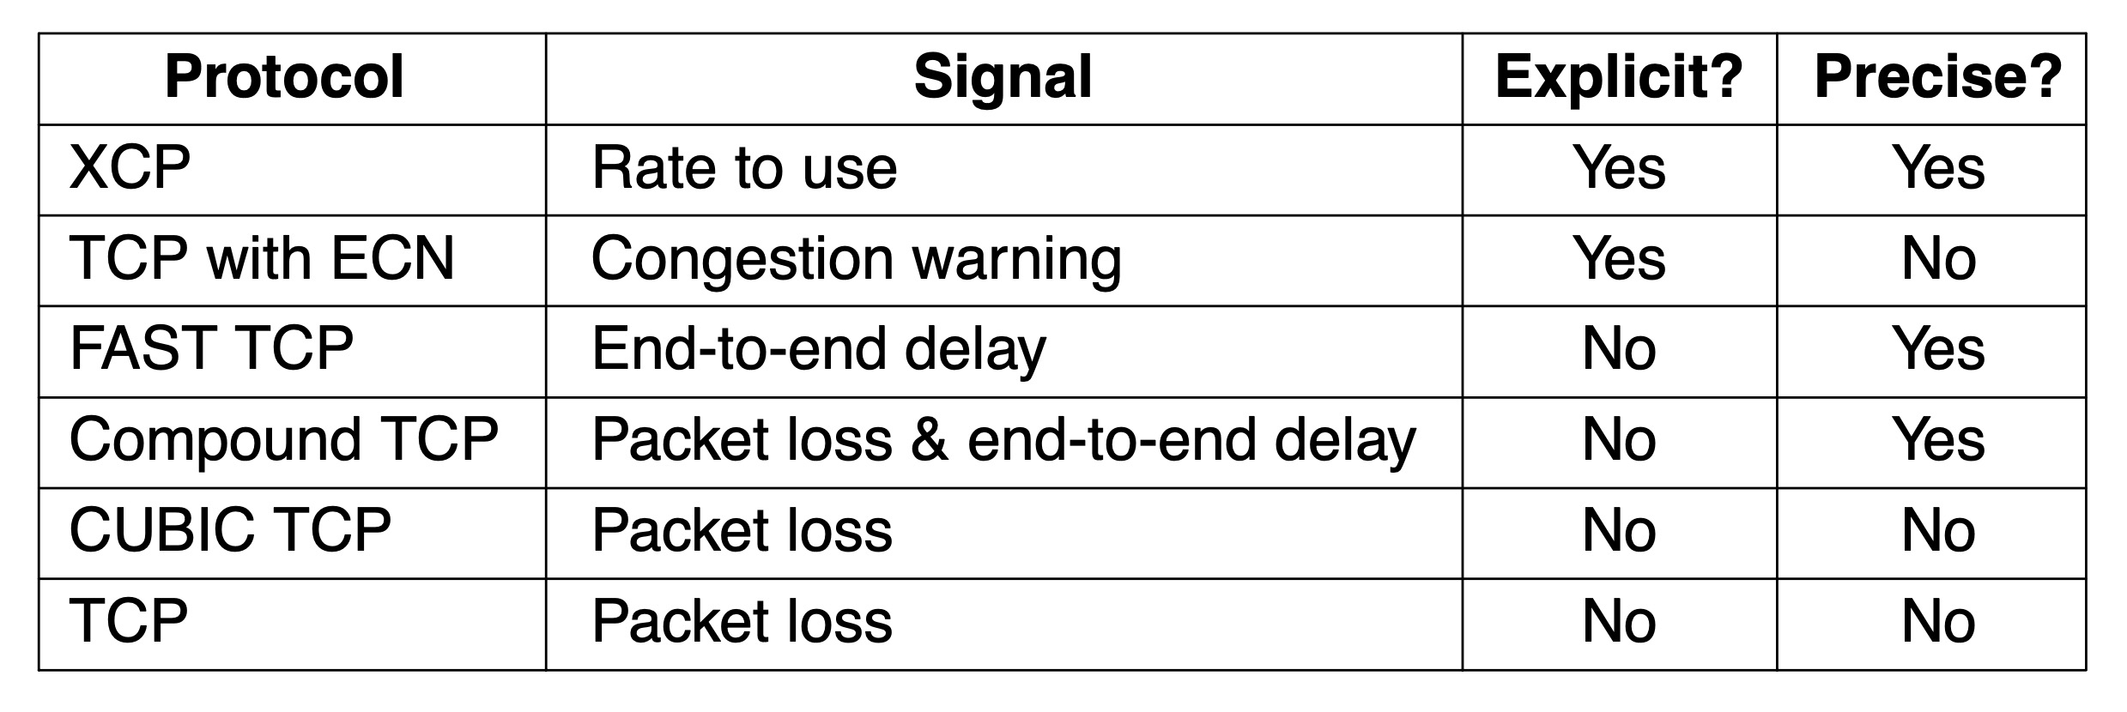
Regulating the Sending Rate (2 of 4)
Different congestion signals the network may use to tell the transport endpoint to slow down (or speed up)
Signals of some congestion control protocols

Slide 58
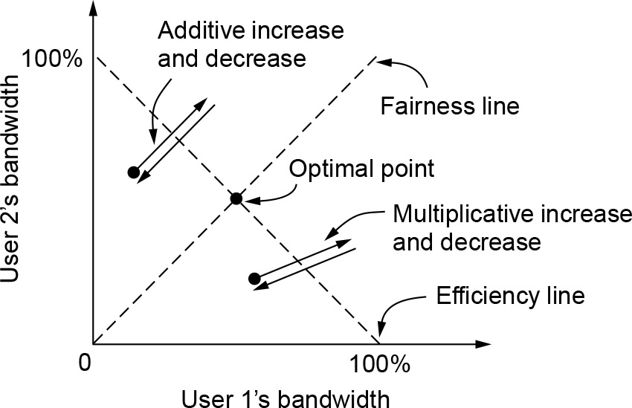
Regulating the Sending Rate (3 of 4)
If two flows increase/decrease their bandwidth in the same way when the network signals free/busy they will not converge to a fair allocation.
Additive and multiplicative bandwidth adjustments
Notes:
The game shows two competing flows. The network is efficient when the sum of the flows is 1 unit, shown by the efficiency line. The network is fair when both flows have the same bandwidth, shown by the fairness line (y=x). Each flow increases or decreases their bandwidth periodically depending on whether the network is uncongested or congested. Additive policies change the bandwidth by a constant amount, like 1 Mbps. Additive changes for both users will thus follow a 45 degree line. Multiplicative policies change the bandwidth by a fractional amount, like 10%. Multiplicative changes for both users will thus go along a line towards or away from the origin. With AIAD or MIMD the flows oscillate over the efficiency line but do not become more fair.

Slide 59
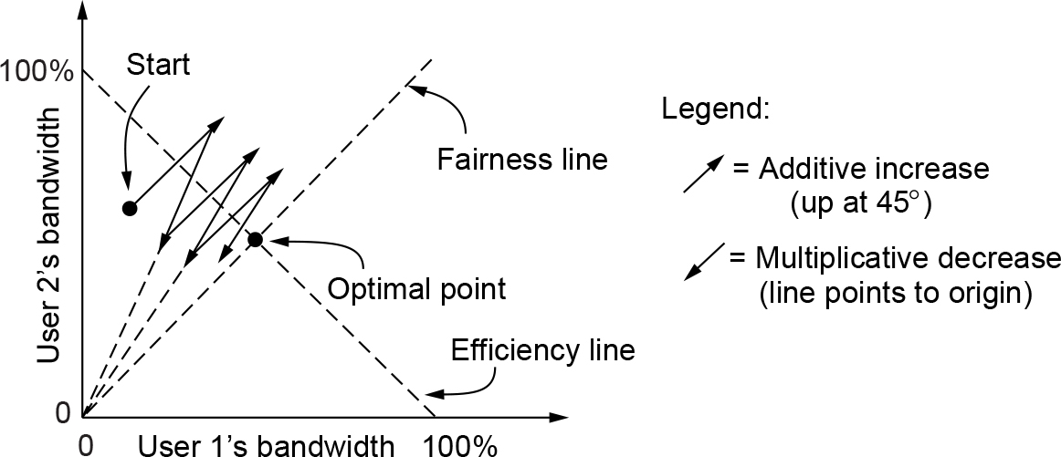
Regulating the Sending Rate (4 of 4)
The AIMD (Additive Increase Multiplicative Decrease) control law does converge to a fair and efficient point!
TCP uses AIMD for this reason
Additive Increase Multiplicative Decrease (AIMD) control law
Notes:
Amazing! Exercise: pick any point for user 1 and user 2’s bandwidth and simulate AIMD. It will move towards the optimal point

Slide 60
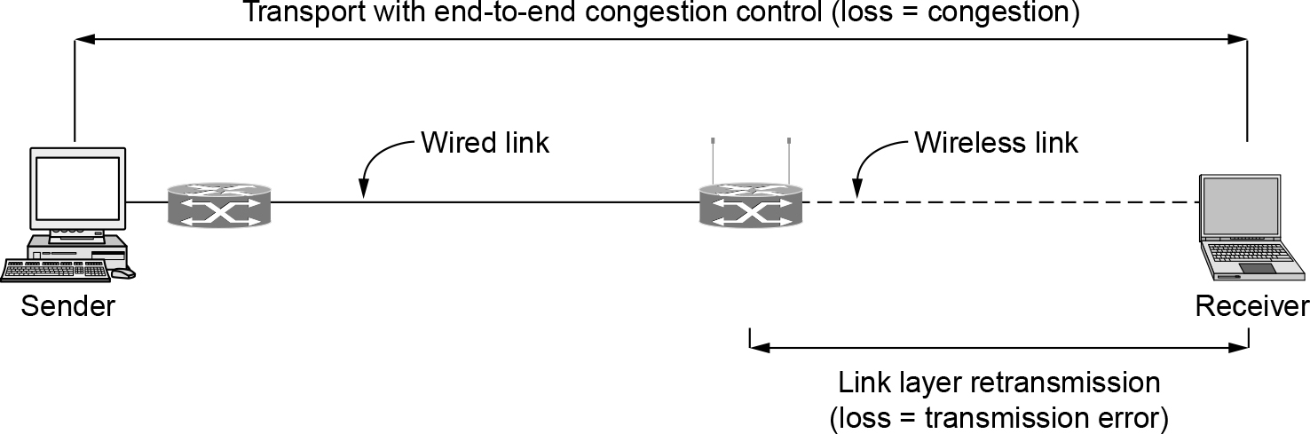
Wireless Issues
Wireless links lose packets due to transmission errors
Do not want to confuse this loss with congestion
Or connection will run slowly over wireless links!
Strategy:
Wireless links use ARQ, which masks errors
Congestion control over a path with a wireless link

Slide 61
The Transport Layer Chapter 6
The Transport Service
Elements of Transport Protocols
Congestion Control
The Internet Transport Protocols: UDP
The Internet Transport Protocols: TCP
Performance Monitoring
Summary

Slide 62
The Internet Transport Protocols: UDP
Introduction to UDP
Remote procedure call
Real-time transport
RTP—the Real-time Transport Protocol
RTCP—the Real-time Transport Control Protocol
Playout with buffering and jitter control

Slide 63
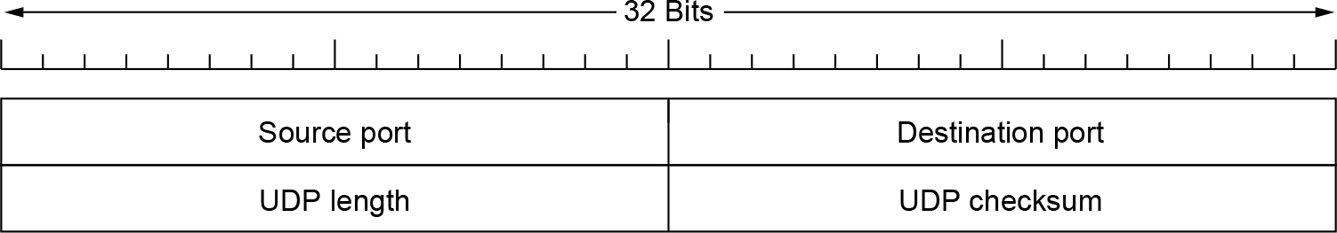
Introduction to UDP (1 of 2)
UDP (User Datagram Protocol) is a shim over IP
Header has ports (TSAPs), length and checksum.
The UDP header

Slide 64

Introduction to UDP (2 of 2)
Checksum covers UDP segment and IP pseudoheader
Fields that change in the network are zeroed out
Provides an end-to-end delivery check
If IP pseudoheader wasn’t covered then nothing would check that the host addresses were correct.
The IPv4 pseudoheader included in the UDP checksum

Slide 65
UDP Applications
For the following applications, is UDP preferable? Why?
Short request-reply application
e.g. DNS (Domain Name System)
Long Message sending application
e.g. SMTP (Simple Mail Transfer Protocol)
Large file downloading application
e.g. FTP (File Transfer Protocol)
Real-time interactive application
e.g. Skype
Notes:
DNS uses the services of UDP because a client needs to send a short request to a server and to receive a quick response from it. The request and response can each fit in one user datagram. Since only one message is exchanged in each direction, the connectionless feature is not an issue; the client or server does not worry that messages are delivered out of order.
SMTP, which is used in electronic mail, cannot use the services of UDP because a user can send a long e-mail message, which may include multimedia (images, audio, or video). If the application uses UDP and the message does not fit in one single user datagram, the message must be split by the application into different user datagrams. Here the connectionless service may create problems. The user datagrams may arrive and be delivered to the receiver application out of order. The receiver application may not be able to reorder the pieces. This means the connectionless service has a disadvantage for an application program that sends long messages.
Assume we are downloading a very large text file from the Internet. We definitely need to use a transport layer that provides reliable service. We don’t want part of the file to be missing or corrupted when we open the file. The delay created between the deliveries of the parts is not an overriding concern for us; we wait until the whole file is composed before looking at it. In this case, UDP is not a suitable transport layer.
Assume we are using a real-time interactive application, such as Skype. Audio and video are divided into frames and sent one after another. If the transport layer is supposed to resend a corrupted or lost frame, the synchronizing of the whole transmission may be lost. The viewer suddenly sees a blank screen and needs to wait until the second transmission arrives. This is not tolerable. However, if each small part of the screen is sent using one single user datagram, the receiving UDP can easily ignore the corrupted or lost packet and deliver the rest to the application program. That part of the screen is blank for a very short period of time, which most viewers do not even notice.

Slide 66


Some well-known ports used with UDP and TCP

Slide 67

Exercise
The following is the contents of a UDP header in hexadecimal format.
a. What is the source port number?
b. What is the destination port number?
c. What is the total length of the user datagram?
d. What is the length of the data?
e. Is the packet directed from a client to a server or vice versa?
f. What is the client process?

Slide 68
Solution
a. The source port number is the first four hexadecimal digits (CB84)₁₆ or 52100
b. The destination port number is the second four hexadecimal digits (000D)₁₆ or 13.
c. The third four hexadecimal digits (001C)₁₆ define the length of the whole UDP packet as 28 bytes.
d. The length of the data is the length of the whole packet minus the length of the header, or 28 − 8 = 20 bytes.
e. Since the destination port number is 13 (well-known port), the packet is from the client to the server.
f. The client process is the Daytime.

Slide 69

Remote Procedure Call
RPC connects applications over the network with the familiar abstraction of procedure calls
Stubs package parameters/results into a message
UDP with retransmissions is a low-latency transport
Steps in making a remote procedure call. The stubs are shaded.

Slide 70

gPRC
gRPC can use protocol buffers as both its Interface Definition Language (IDL) and as its underlying message interchange format
By default, gRPC uses Protocol Buffers, Google’s mature open source mechanism for serializing structured data (although it can be used with other data formats such as JSON).
A client application can directly call a method on a server application on a different machine as if it were a local object, making it easier for you to create distributed applications and services
Notes:
In gRPC, a client application can directly call a method on a server application on a different machine as if it were a local object, making it easier for you to create distributed applications and services. As in many RPC systems, gRPC is based around the idea of defining a service, specifying the methods that can be called remotely with their parameters and return types. On the server side, the server implements this interface and runs a gRPC server to handle client calls. On the client side, the client has a stub (referred to as just a client in some languages) that provides the same methods as the server.
gRPC clients and servers can run and talk to each other in a variety of environments - from servers inside Google to your own desktop - and can be written in any of gRPC’s supported languages. So, for example, you can easily create a gRPC server in Java with clients in Go, Python, or Ruby. In addition, the latest Google APIs will have gRPC versions of their interfaces, letting you easily build Google functionality into your applications.

Slide 71

Real-Time Transport Protocols (1 of 4)
RTP (Real-time Transport Protocol) provides support for sending real-time media over UDP
Often implemented as part of the application
(a) The position of RTP in the protocol stack. (b) Packet nesting.

Slide 72

Real-Time Transport Protocols (2 of 4)
RTP header contains fields to describe the type of media and synchronize it across multiple streams
RTCP sister protocol helps with management tasks
The RTP header

Slide 73

Real-Time Transport Protocols (3 of 4)
Buffer at receiver is used to delay packets and absorb jitter so that streaming media is played out smoothly
Smoothing the output stream by buffering packets

Slide 74

Real-Time Transport Protocols (4 of 4)
High jitter, or more variation in delay, requires a larger playout buffer to avoid playout misses
Propagation delay does not affect buffer size
(a) High jitter. (b) Low jitter.

Slide 75
The Transport Layer Chapter 6
The Transport Service
Elements of Transport Protocols
Congestion Control
The Internet Transport Protocols: UDP
The Internet Transport Protocols: TCP
Performance Monitoring
Summary

Slide 76
The Internet Transport Protocols: TCP (1 of 2)
Introduction to TCP
The TCP service model
The TCP protocol
The TCP segment header
TCP connection establishment
TCP connection release

Slide 77
The Internet Transport Protocols: TCP (2 of 2)
TCP connection management modeling
TCP sliding window
TCP timer management
TCP congestion control
TCP CUBIC

Slide 78

The TCP Service Model (1 of 2)
TCP provides applications with a reliable byte stream between processes; it is the workhorse of the Internet
Popular servers run on well-known ports
Some assigned ports

Slide 79

The TCP Service Model (2 of 2)
Applications using TCP see only the byte stream [right] and not the segments [left] sent as separate IP packets
(a) Four 512-byte segments sent as separate IP datagrams. (b) The 2048 bytes of data delivered to the application in a single READ call.

Slide 80

The TCP Segment Header
TCP header includes addressing (ports), sliding window (seq. / ack. number), flow control (window), error control (checksum) and more.
The TCP header

Slide 81
Flags in TCP Header (1 of 2)
ECE: to signal an ECN-Echo to a TCP sender to tell it to slow down when the TCP receiver gets a congestion indication from the network.
CWR: to signal Congestion Window Reduced from the TCP sender to the TCP receiver so that it knows the sender has slowed down and can stop sending the ECN-Echo.
URG: allowing the sender to signal the receiver to accept some urgent data without getting TCP itself involved in the reason for the interrupt, but it is seldom used. The Urgent pointer is used to indicate a byte offset from the current sequence number at which urgent data are to be found.
ACK: to indicate that the Acknowledgement number is valid. This is the case for nearly all packets.
PSH: to request the receiver to deliver the data to the application upon arrival and not buffer it until a full buffer has been received (which it might otherwise do for efficiency).
Notes:
a bare-bones way: 简陋的方式
The objective of the TCP urgent mechanism is to allow the sending user to stimulate the receiving user to accept some urgent data and to permit the receiving TCP to indicate to the receiving user when all the currently known urgent data has been received by the user.
This mechanism permits a point in the data stream to be designated as the end of urgent information. Whenever this point is in advance of the receive sequence number (RCV.NXT) at the receiving TCP, that TCP must tell the user to go into "urgent mode"; when the receive sequence number catches up to the urgent pointer, the TCP must tell user to go into "normal mode". If the urgent pointer is updated while the user is in "urgent mode", the update will be invisible to the user.
The TCP is able to transfer a continuous stream of octets in each direction between its users by packaging some number of octets into segments for transmission through the internet system. In general, the TCPs decide when to block and forward data at their own convenience. Sometimes users need to be sure that all the data they have submitted to the TCP has been transmitted. For this purpose a push function is defined. To assure that data submitted to a TCP is actually transmitted the sending user indicates that it should be pushed through to the receiving user. A push causes the TCPs to promptly forward and deliver data up to that point to the receiver. The exact push point might not be visible to the receiving user and the push function does not supply a record boundary marker.

Slide 82
Flags in TCP Header (2 of 2)
RST: to abruptly reset a connection that has become confused due to a host crash or for some other reason. It is also used to reject an invalid segment or refuse an attempt to open a connection.
SYN: to establish connections.
The connection request has SYN = 1 and ACK = 0 to indicate that the piggyback acknowledgement field is not in use. The connection reply does bear an acknowledgement, however, so it has SYN = 1 and ACK = 1.
the SYN bit is used to denote both CONNECTION REQUEST and CONNECTION ACCEPTED, with the ACK bit used to distinguish between those two possibilities.
FIN: to release a connection. It specifies that the sender has no more data to transmit.
However, after closing a connection, the closing process may continue to receive data indefinitely. Both SYN and FIN segments have sequence numbers and are thus guaranteed to be processed in the correct order.

Slide 83
Window size
Flow control in TCP is handled using a variable-sized sliding window.
In the protocols of Chap. 3, acknowledgements of frames received and permission to send new frames were tied together. This was a consequence of a fixed window size for each protocol.
In TCP, acknowledgements and permission to send additional data are completely decoupled. In effect, a receiver can say: ‘‘I have received bytes up through k but I do not want any more just now, thank you.’’ This decoupling (in fact, a variable-sized window) gives additional flexibility.
Window size: how many bytes may be sent starting at the byte acknowledged.
A Window size field of 0 is legal and says that the bytes up to and including Acknowledgement number - 1 have been received, but that the receiver has not had a chance to consume the data and would like no more data for the moment.
The receiver can later grant permission to send by transmitting a segment with the same Acknowledgement number and a nonzero Window size field.

Slide 84
Checksum and Options
Checksum: is provided for extra reliability.
It checksums the header, the data, and a conceptual pseudoheader in exactly the same way as UDP, except that the pseudoheader has the protocol number for TCP (6) and the checksum is mandatory.
Options: provides a way to add extra facilities not covered by the regular header.
The options are of variable length, fill a multiple of 32 bits by using padding with zeros, and may extend to 40 bytes to accommodate the longest TCP header that can be specified.
Some options are carried when a connection is established to negotiate or inform the other side of capabilities. Other options are carried on packets during the lifetime of the connection.
Each option has a Type-Length-Value encoding.

Slide 85
Commonly Used Options (1 of 2)
MSS (Maximum Segment Size) option
allows each host to specify the MSS it is willing to accept.
During connection setup, each side can announce its maximum and see its partner’s.
The maximum segment size in the two directions need not be the same.
window scale option
allows the sender and receiver to negotiate a window scale factor at the start of a connection.
Both sides use the scale factor to shift the Window size field up to 14 bits to the left, thus allowing windows of up to 2³⁰ bytes.

Slide 86
Commonly Used Options (2 of 2)
timestamp option
carries a timestamp sent by the sender and echoed by the receiver.
It is included in every packet, once its use is established during connection setup, and used to compute round-trip time samples that are used to estimate when a packet has been lost.
It is also used as a logical extension of the 32-bit sequence number to avoid the sequence number wrapped around quickly.
SACK (Selective ACKnowledgement) option
lets a receiver tell a sender the ranges of sequence numbers that it has received.
It supplements the Acknowledgement number and is used after a packet has been lost but subsequent (or duplicate) data has arrived.
SACK is defined in RFC 2108 and RFC 2883 and is increasingly used.
Notes:
PAWS: Protection Against Wrapped Sequences

Slide 87
About Sequence Number and Window Size
Make sure the sequence number does not wrap around within the maximum segment lifetime (MSL). This depends on how fast data can be transmitted over the Internet.
For 32-bit sequence number space (TCP), IETF define an extension to extend the sequence number space to protect against the sequence number wrapping around.
Keep the pipe full: the bandwidth delay product indicates how big Window Size (Advertised Window) field needs to be.
For 16-bit Window Size field (TCP), only 64KB is allowed. Solution: also extension to TCP.

Slide 88
Exercise 1
Suppose TCP operates over a 40-Gbps STS-768 link.
(a) Assuming TCP could utilize the full bandwidth continuously, how long would it take the sequence numbers to wrap around completely?
(b) Suppose an added 32-bit timestamp field which increments 1000 times during the wraparound time you found above. How long would it take for the timestamp to wrap around?
Solution:
(a) 2³² Bytes / (40/8) GBps = 859 ms
(b) 1000 ticks in 859 ms, 1 tick in 859 μs. 2³² * 859 μs = 3.7Ms, approximately 43 days

Slide 89
Exercise 2
You are hired to design a reliable byte-stream protocol that uses a sliding window (like TCP). This protocol will run over a 1-Gbps network. The RTT of the network is 140 ms, and the maximum segment lifetime is 60 seconds. How many bits would you include in the AdvertisedWindow and SequenceNum fields of your protocol header?
Solution:
The AdvertisedWindow should be large enough to keep the pipe full.
Bandwidth Delay (RTT) Product = 1Gbps * 140 ms = 17.5 Mbytes
AdvertisedWindow filed: 25 bits
The sequence number must not wrap around within the maximum segment lifetime.
1 Gbps * 60 s = 60 Gb = 7.5 GB
SequenceNum filed: 33 bits

Slide 90

TCP Connection Establishment
TCP sets up connections with the three-way handshake
Release is symmetric, also as described before
connection request is a SYN, for synchronize, disconnect request is a FIN for finish.
(a) TCP connection establishment in the normal case. (b) Simultaneous connection establishment on both sides.

Slide 91










Connection Establishment using Three-way Handshaking

Slide 92










Data Transfer

Slide 93







Connection Termination using three-way handshaking

Slide 94



Half-close
z

Slide 95

TCP Connection Management Modeling (1 of 2)
The states used in the TCP connection management finite state machine

Slide 96

TCP Connection Management Modeling (2 of 2)
TCP connection management finite state machine. The heavy solid line is the normal path for a client. The heavy dashed line is the normal path for a server. The light lines are unusual events. Each transition is labeled with the event causing it and the action resulting from it, separated by a slash.
Notes:
Exercise: using two instances of this, follow the path of a normal connection from a three-way handshake (both sides should move from closed to established using socket calls and packet exchanges) to teardown (both sides should move to closed at bottom). Ignore packet loss as it is not covered here. Then try a simultaneous open, etc.

Slide 97

A Common Scenario

Slide 98

TCP Sliding Window (1 of 2)
TCP adds flow control to the sliding window as before
ACK + WIN is the sender’s limit
Window management in TCP
Notes:
To see why the figure is correct about where the data lies in the buffer note that it is a circular buffer. Data is put in from left to right then starts at the left edge again (bottom). Similarly, data is read out left to right (second from bottom).

Slide 99

TCP Sliding Window (2 of 2)
Need to add special cases to avoid unwanted behavior
E.g., silly window syndrome [below]
Receiver application reads single bytes, so sender always sends one byte segments
Silly window syndrome
Notes:
These sort of things problems crop up in practice as being part of the mechanisms we have described so far. They usually call for modified sliding window / flow control rules in special cases. Solution for silly window syndrome is that receiver should not send window updates for tiny buffer openings like “one byte available”. It should wait until a whole segment can be buffered to avoid this.

Slide 100

TCP Timer Management
TCP estimates retransmit timer from segment RTTs
Tracks both average and variance (for Internet case)
Timeout is set to average plus 4 x variance
(a) Probability density of acknowledgement arrival times in the data link layer. (b) Probability density of acknowledgement arrival times for TCP.

Slide 101
TCP Congestion Control (1)
TCP uses AIMD with loss signal to control congestion
Implemented as a congestion window (cwnd) for the number of segments that may be in the network
Uses several mechanisms that work together
Name | Mechanism | Purpose
ACK clock | Congestion window (cwnd) | Smooth out packet bursts
Slow-start | Double cwnd each RTT | Rapidly increase send rate to reach roughly the right level
Additive Increase | Increase cwnd by 1 packet each RTT | Slowly increase send rate to probe at about the right level
Fast retransmit / recovery | Resend lost packet after 3 duplicate ACKs; send new packet for each new ACK | Recover from a lost packet without stopping ACK clock

Slide 102

TCP Congestion Control (1 of 6)
Congestion window controls the sending rate
Rate is cwnd / RTT; window can stop sender quickly
ACK clock (regular receipt of ACKs) paces traffic and smoothes out sender bursts
A burst of packets from a sender and the returning ack clock
ACKs pace new segments into the network and smooth bursts

Slide 103

TCP Congestion Control (2 of 6)
Slow start grows congestion window exponentially
Doubles every RTT while keeping ACK clock going
Increment cwnd for each new ACK
Slow start from an initial congestion window of one segment
Notes:
It’s only slow compared to jumping to a large window immediately, which was how it used to work when slow-start was invented.

Slide 104

TCP Congestion Control (3 of 6)
Additive increase grows cwnd slowly
Adds 1 every RTT
Keeps ACK clock
Additive increase from an initial congestion window of one segment

Slide 105

TCP Congestion Control (4 of 6)
Slow start followed by additive increase (TCP Tahoe)
Threshold is half of previous loss cwnd
new ack:
if (cwnd < sstresh)
cwnd += 1
else
cwnd += 1/cwnd
timeout/3rd dup ack:
retransmit all unacked
ssthresh = cwnd/2
cwnd = 1
Loss causes timeout; ACK clock has stopped so slow-start again
Slow start followed by additive increase in TCP Tahoe
Improving TCP Tahoe: Packets still getting through in dup ack – no need to reset the clock!
Notes:
Slow-start switches to additive increase at the slow-start threshold, which is set to be half the cwnd at the previous data loss. (First loss that finds this threshold is not shown.)
With both slow-start and additive increase the connection spends much of its time with a reasonable cwnd. But we have to start over after loss because by the time it is detected the ACK clock has stopped.

Slide 106

TCP Congestion Control (5 of 6)
With fast recovery, we get the classic sawtooth (TCP Reno)
Retransmit lost packet after 3 duplicate ACKs
New packet for each dup. ACK until loss is repaired
new ack:
if (cwnd < sstresh)
cwnd += 1
else
cwnd += 1/cwnd
3rd duplicate ACK:
fast retransmission
i.e., retransmit 1st unacked
fast recovery
ssthresh = cwnd/2
cwnd = cwnd/2
The ACK clock doesn’t stop, so no need to slow-start
timeout:
retransmit 1st unacked
ssthresh = cwnd/2
cwnd = 1
Notes:
With fast recovery, the packet loss is detected with three duplicate ACKs, the lost packet (next to be ACKed) is retransmitted (fast retransmit), the cwnd is halved, and then a new packet is sent for each acknowledgment that is received. Eventually the ack will jump forward when the retransmission fills the hole, and at that point we synchronize.

Slide 107

TCP Congestion Control (6 of 6)
SACK (Selective ACKs) extend ACKs with a vector to describe received segments and hence losses
Allows for more accurate retransmissions / recovery
No way for us to know that 2 and 5 were lost with only ACKs
Selective acknowledgements

Slide 108
Typical TCP Congestion Control Algorithms
TCP Tahoe
CWND = 1 on timeout & triple dupACK
TCP Reno
CWND = 1 on timeout
CWND = CWND/2 on triple dupACK
TCP-newReno
TCP-Reno + improved fast recovery
TCP-SACK
Incorporates selective acknowledgements

Slide 109
ECN as a congestion signal
During connection establishment, both the sender and receiver indicate that they are capable of using ECN by setting the ECE and CWR bits.
Each packet that carries a TCP segment is flagged in the IP header to show that it can carry an ECN signal. Routers will set a congestion signal on packets that can carry ECN flags when congestion is approaching, instead of dropping those packets after congestion has occurred.
The TCP receiver is informed if any packet that arrives carries an ECN congestion signal. The receiver then uses the ECE (ECN Echo) flag to signal the TCP sender that its packets have experienced congestion.
The sender tells the receiver that it has heard the signal by using the CWR (Congestion Window Reduced) flag. The TCP sender reacts to these congestion notifications in exactly the same way as it does to packet loss that is detected via duplicate acknowledgements. However, the situation is strictly better. Congestion has been detected and no packet was harmed in any way. ECN is described in RFC 3168.

Slide 110

TCP CUBIC
Networks with large bandwidth-delay products take many round-trip times to reach the available capacity of the end-to-end path.
TCP CUBIC increases and adjust the congestion window as a function of the time since the last duplicate acknowledgment, rather than simply based on the arrival of ACKs.
TCP CUBIC is implemented by default in the Linux kernels 2.6.19 and above, as well as modern versions of Windows.
In contrast to AIMD, the congestion window increases according to a cubic function, which initially has a growth in the congestion window, followed by a plateau period, and finally a period of faster growth.
Evolution of TCP CUBIC Congestion Window
Notes:
plateau period: 平稳期，停滞期

Slide 111
Transport Protocols and Congestion Control
QUIC: Quick UDP Internet Connections
BBR: Congestion control based on bottleneck bandwidth
The future of TCP

Slide 112
QUIC (Quick UDP Internet Connections)
QUIC: A transport protocol runs on top of UDP that aims to improve some of the throughput and latency characteristics of TCP to make application protocols such as the Web protocols faster
It was used in more than half of the connections from the Chrome browser to Google’s services before it was ever standardized.
It aims to multiplex these connections over a single UDP flow, while also ensuring that if a single Web object transfer is delayed, that it does not ultimately block the transfer of other objects.
If some data is lost in one stream, the protocol can continue transferring data for other streams independently, which can ultimately improve the performance of links with high transmission error rates.
QUIC also makes various other optimizations to improve performance
piggybacking application-level encryption information on transport-connection establishment
encrypting each packet individually so that the loss of one packet does not prevent decryption of subsequent packets
improving the speed of network handoff (e.g., from a cellular connection to a WiFi connection)
using a connection identifier as a way to maintain state when endpoints change networks.
Notes:
an application such as the Web relies on establishing multiple connections in parallel to load an individual Web page.
Because many of those connections are to a common server, establishing a new connection to load each individual Web object can result in significant overhead.

Slide 113
BBR: Congestion Control Based on Bottleneck Bandwidth
Bufferbloat: when network devices in along a network path have buffers that are too large, a TCP sender with a large congestion window can send at a rate that far exceeds the capacity of the network before it ever receives a loss signal. Buffers in the middle of the network can fill up, delaying congestion events for senders that are sending too fast (i.e., not dropping packets) and, importantly, increasing the network latency for senders whose packets are queued behind the packets in a large buffer (Gettys, 2011).
Addressing bufferbloat
simply to reduce the size of buffers in network devices
to develop an alternative to loss-based congestion control, which is the approach BBR takes.

Slide 114
The General Philosophy of BBR
BBR continuously tracks the bottleneck bandwidth and the round-trip propagation delay
TCP already tracks the round-trip time; BBR extends existing functionality by tracking the delivery rate of the transport protocol over time.
BBR effectively computes the bottleneck bandwidth as the maximum of the measured delivery rate over a given time window—typically six to ten round trips.
Up to the bandwidth-delay product of the path, the round-trip time will not increase because no additional buffering is taking place;
The delivery rate will remain inversely proportional to the round-trip time and proportional to the amount of packets in flight (the window).
Once the amount of packets in flight exceeds the bandwidth-delay product, latency begins to increase as packets are queued, and the delivery rate plateaus. It is at this point that BBR seeks to operate.

Slide 115

The optimal operating point for BBR
continually update estimates of the bottleneck bandwidth and round-trip latency accordingly
pace the data itself to match the bottleneck bandwidth rate
round trip time and delivery rate
V.S. the amount of data in flight (i.e., sent, but not acknowledged).
The optimal operating point for BBR: when increasing the amount of traffic in flight increases the overall round-trip time but does not increase the delivery rate.
BBR Operating Point

Slide 116
The Future of TCP
TCP will continue to evolve
TCP issues
Does not provide transport semantics applications want
send messages or records whose boundaries need to be preserved.
work with a group of related conversations, such as a Web browser that transfers several objects from the same server.
want better control over the network paths that they use.
Application must deal with problems not solved by TCP
Proposals providing a slightly different interface
SCTP and SST
Must deal with “If it ain’t broke, don’t fix it’’ mentality

Slide 117
The Transport Layer Chapter 6
The Transport Service
Elements of Transport Protocols
Congestion Control
The Internet Transport Protocols: UDP
The Internet Transport Protocols: TCP
Performance Monitoring
Summary

Slide 118
Performance Issues
Performance problems
Measuring network performance
Measuring access network throughput
Measuring quality of experience
Host design for fast networks
Fast segment processing
Header compression
Protocols for ‘‘long fat’’ networks

Slide 119
Performance Problems in Computer Networks
Temporary resource overloads
Structural resource imbalance
Synchronous overloads
Broadcast storm from a bad segment
Power returning after power failure
Lack of system tuning
Low buffer space
Setting timeouts
Jitter

Slide 120
Network Performance Measurement
Access network throughput measurement
Run speed test
Measuring link access speed has become more challenging
Filling the pipe requires more data
Under-test client/server bottlenecks move elsewhere in the network
Speed is less relevant to network performance
Quality of experience or application performance more important

Slide 121
Measuring Access Network Throughput
Best practices
Use multiple parallel TCP connections to fill the capacity of the access link
Perform access network throughput tests directly from the home router
Measure multiple Internet destinations in parallel from a single access connection
Develop ‘‘passive’’ throughput tests

Slide 122
Measuring Quality of Experience
Modern network performance measurement
Moving beyond simple speed tests
Typically based on passive observation of network traffic
User’s quality of experience
Measures person’s happiness with a service
A human consideration
Might require human feedback
Future technique
Automatic estimation of user quality of experience
Based on passive measurement of features in network traffic

Slide 123
Host Design for Fast Networks
Host speed is more important than network speed
Reduce packet count to reduce overhead
Minimize data touching
Minimize context switches
Avoiding congestion is better than recovering from it
Avoid timeouts

Slide 124

Minimize Context Switches
Four context switches to handle one packet with a user-space network manager

Slide 125

Fast Segment Processing (1 of 3)
The fast path from sender to receiver is shown with a heavy line. The processing steps on this path are shaded.

Slide 126

Fast Segment Processing (2 of 3)
(a) TCP header. (b) IP header. In both cases, they are taken from the prototype without change.

Slide 127

Fast Segment Processing (3 of 3)
A timing wheel

Slide 128

Protocols for Long Fat Networks (1 of 2)
The state of transmitting 1 Mbit from San Diego to Boston. (a) At t = 0. (b) After 500 µsec. (c) After 20 msec. (d) After 40 msec.

Slide 129

Protocols for Long Fat Networks (2 of 2)
Time to transfer and acknowledge a 1-Mbit file over a 4000-km line

Slide 130
The Transport Layer Chapter 6
The Transport Service
Elements of Transport Protocols
Congestion Control
The Internet Transport Protocols: UDP
The Internet Transport Protocols: TCP
Performance Monitoring
Summary

Slide 131
Summary (1 of 2)
The transport layer provides various services, the most important of which is an end-to-end, reliable, connection-oriented byte stream from sender to receiver.
It is accessed through service primitives that permit the establishment, use, and release of connections. A common transport layer interface is the one provided by Berkeley sockets.
The transport layer must handle all the service primitives, manage connections and timers, allocate bandwidth with congestion control, and run a variable-sized sliding window for flow control.
the existence of delayed duplicate packets that can reappear at inopportune moments
three-way handshaking connection establishment and release
Congestion control should allocate all of the available bandwidth between competing flows fairly, and it should track changes in the usage of the network. The AIMD control law converges to a fair and efficient allocation.

Slide 132
Summary (2 of 2)
UDP is a connectionless protocol
a wrapper for IP packets with the additional feature of multiplexing and demultiplexing multiple processes using a single IP address.
can be used for client-server interactions, for example, using RPC.
can also be used for building real-time protocols such as RTP.
TCP provides a reliable, bidirectional, congestion-controlled byte stream with a 20-byte header on all segments.
TCP performance optimizing algorithms from Nagle, Clark, Jacobson, Karn, and others.
TCP CUBIC, QUIC, and BBR are a few of the modern improvements.
Network performance is typically dominated by protocol and segment processing overhead, and this situation gets worse at higher speeds.
Protocols should be designed to minimize the number of segments and work for large bandwidth- delay paths. For gigabit networks, simple protocols and streamlined processing work best.

Slide 133

Copyright
This work is protected by United States copyright laws and is provided solely for the use of instructors in teaching their courses and assessing student learning. Dissemination or sale of any part of this work (including on the World Wide Web) will destroy the integrity of the work and is not permitted. The work and materials from it should never be made available to students except by instructors using the accompanying text in their classes. All recipients of this work are expected to abide by these restrictions and to honor the intended pedagogical purposes and the needs of other instructors who rely on these materials.

